Slide 1
COMPUTER NETWORKING - NETWORK FUNDAMENTALS

Slide 2
Network Infrastructure
Network Infrastructure is about the physical component of a network, including hardware and software, which ultimately helps enable network connectivity and communication between users, devices, the internet, and more.
It also includes the cabling and additional wiring that connect these devices.
A network framework is critical to the functioning of any network, and it is essential to carefully plan and design it to ensure optimal performance.

Slide 3
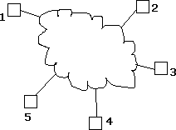
Introduction to Networks
A Network: A group of devices that can communicate with each other over links.
Each device is called a host. Each host has a unique address.

Slide 4
Network is a connection between two or more devices.
Which is connected by a communication links.
A node can be computer, printer or any other devices which is capable of sending and receiving information at each other.

Slide 5
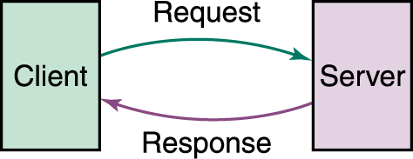
Example:

Slide 6
















INTERNET
An internet:
each host has an address of the form n/h where n is the network number and h is the number of the host on network n.

Slide 7
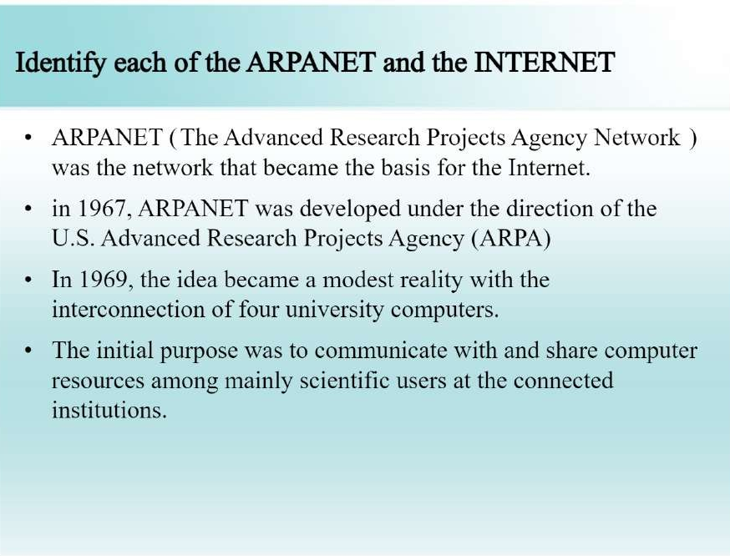

Slide 8
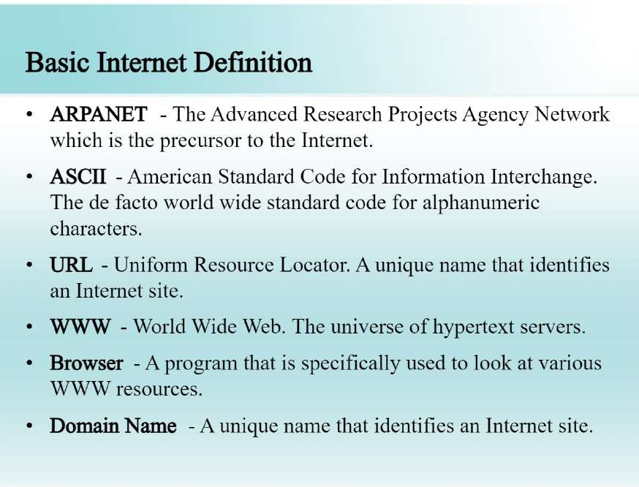

Slide 9
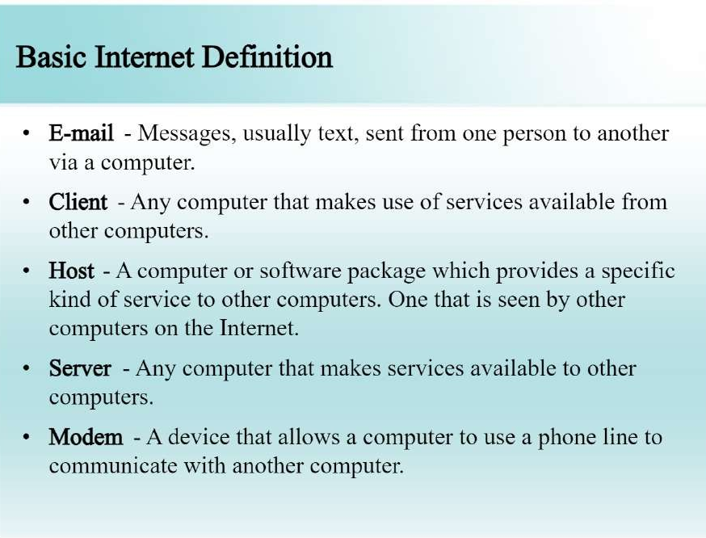

Slide 10
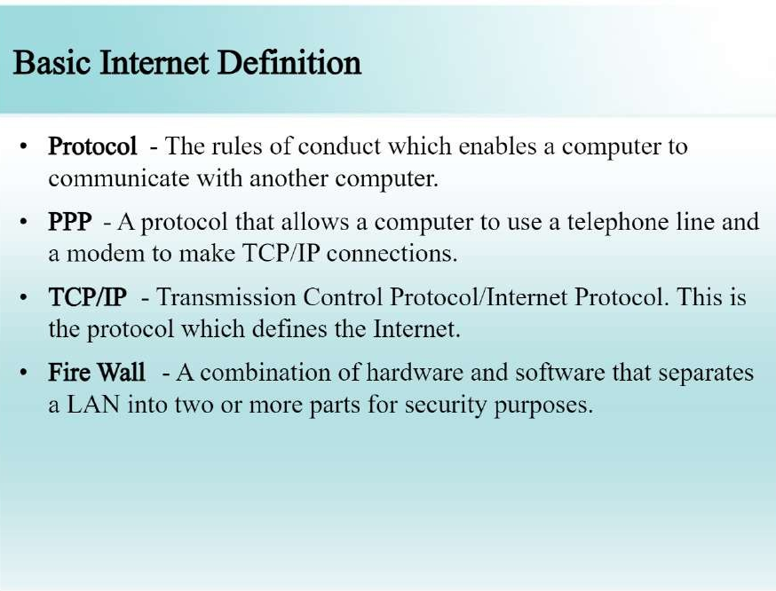
Notes:
PPP: Point to Point Protocol

Slide 11
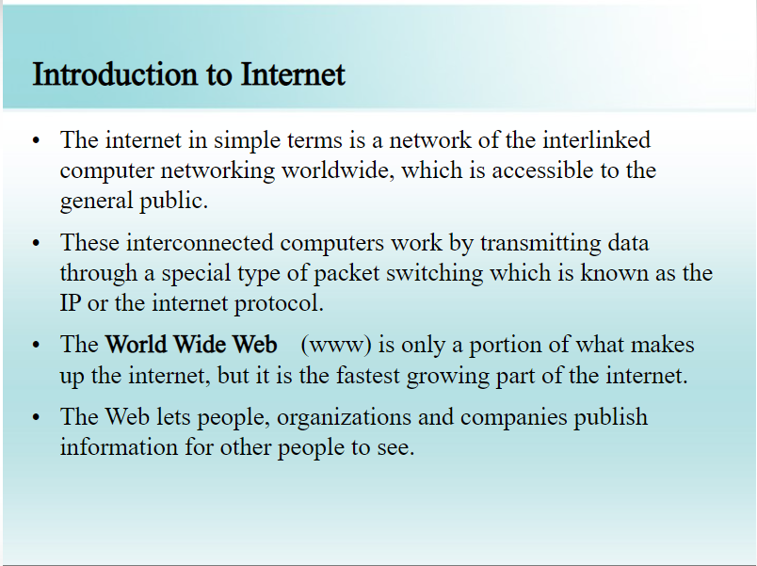
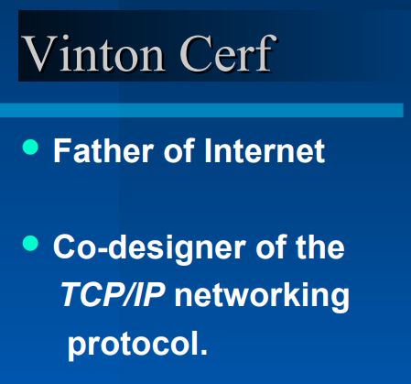

Slide 12
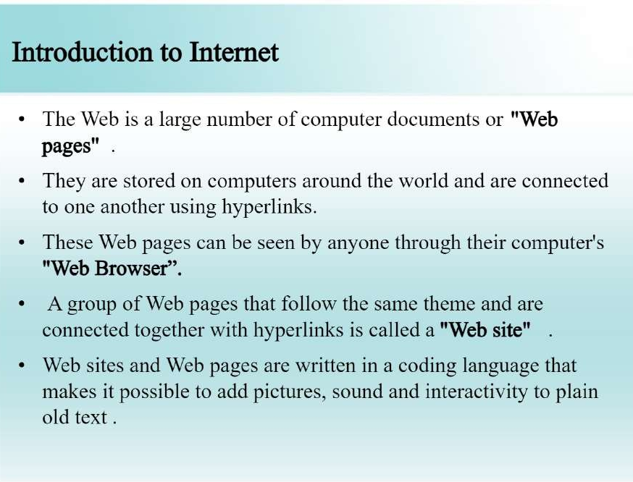

Slide 13

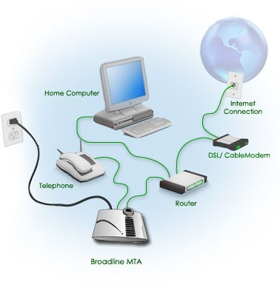
Connect to Internet

Slide 14
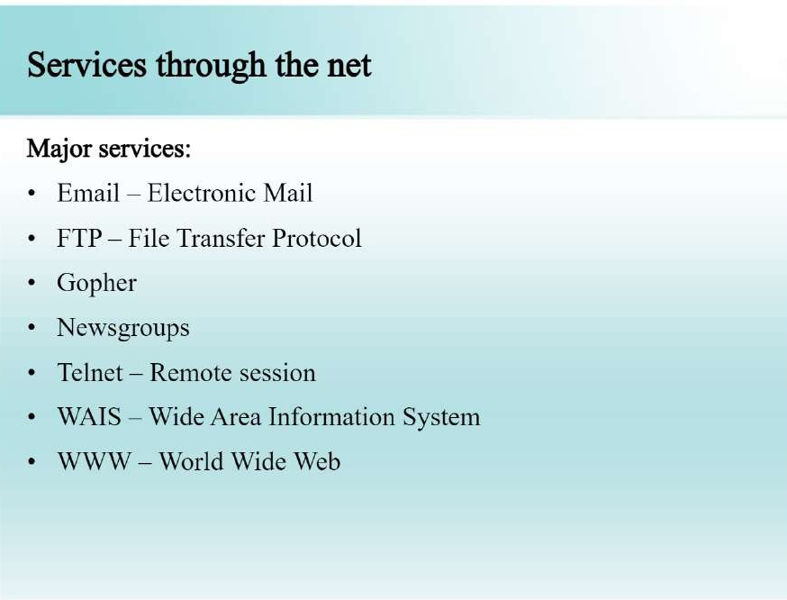
Webpage / Homepage
Web Publishing
Web browser
Search Engine
Protocol
Internet protocol
DNS
HTTP
URL
HTML
ISP
Newsgroup
Video conferencing
Forum

Slide 15
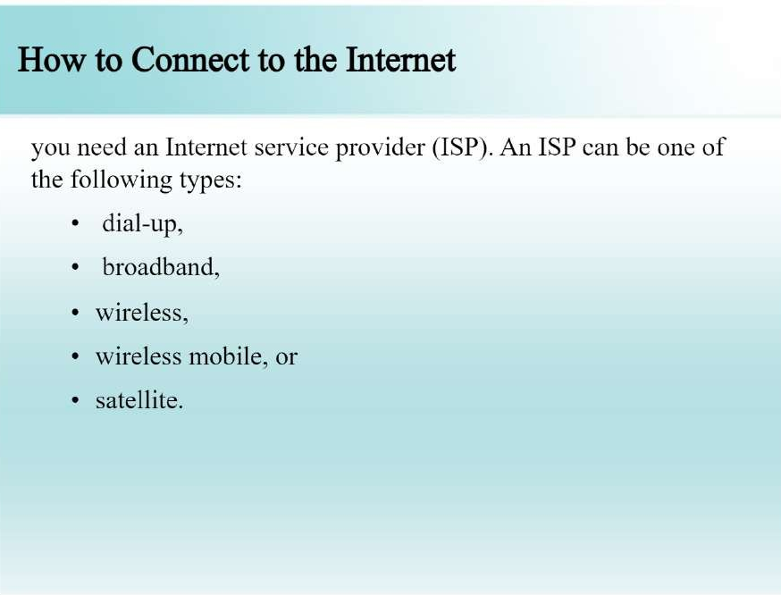

Slide 16
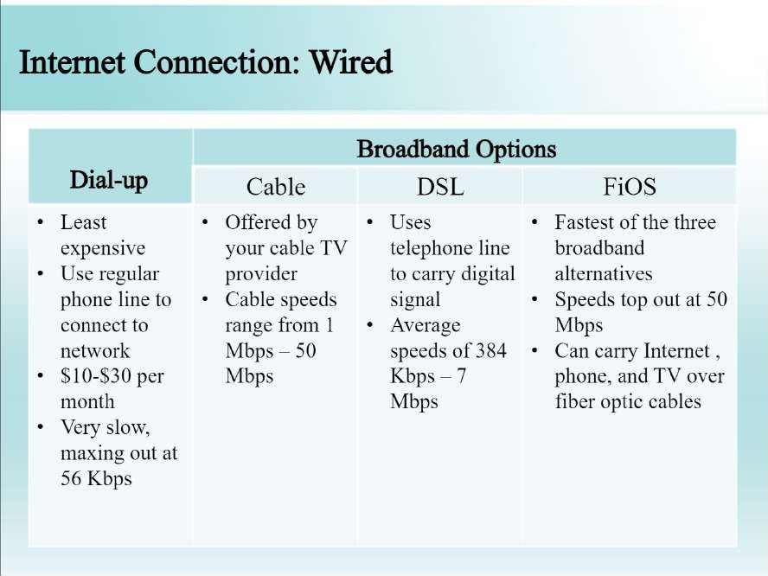

Slide 17
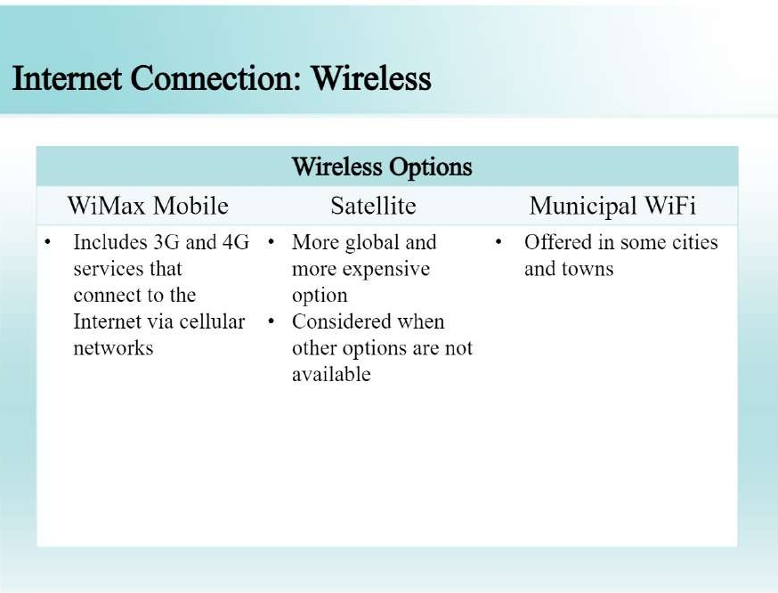

Slide 18
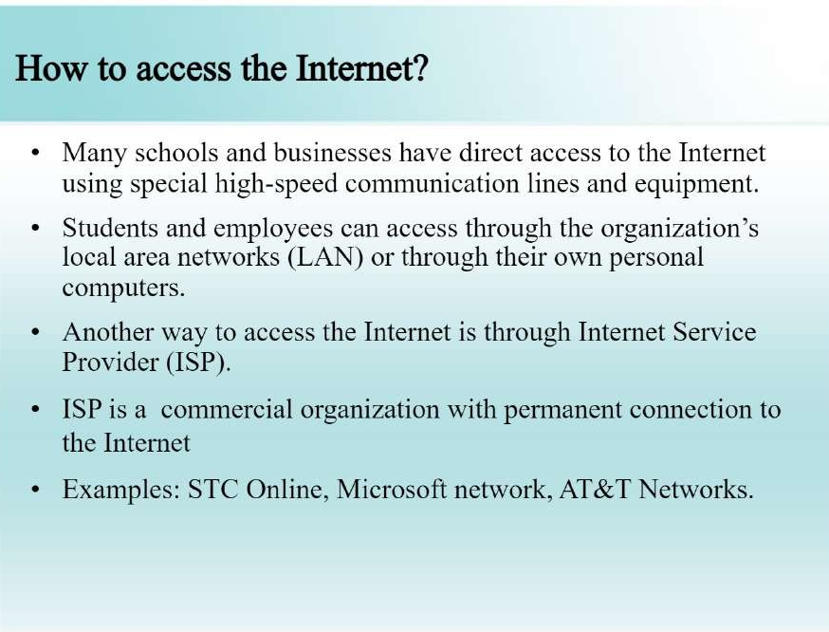

Slide 19
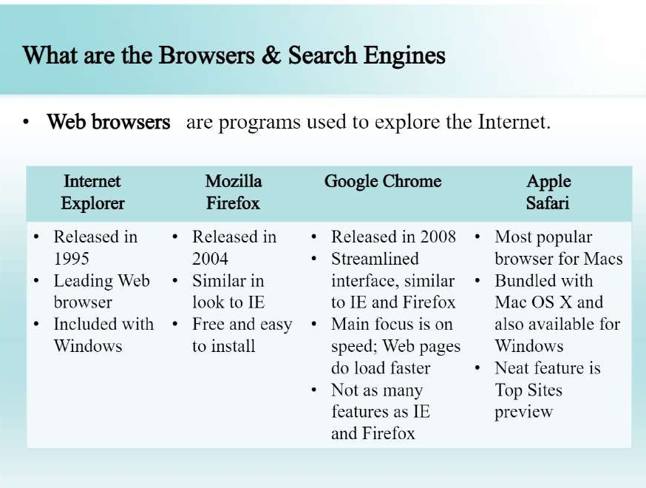

Slide 20
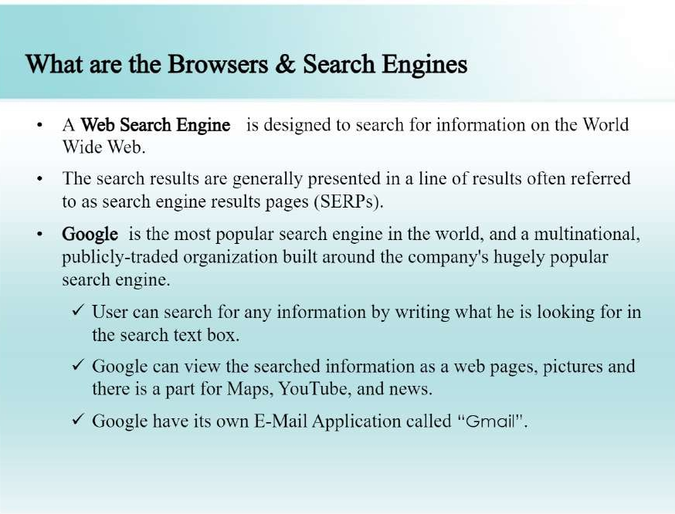

Slide 21
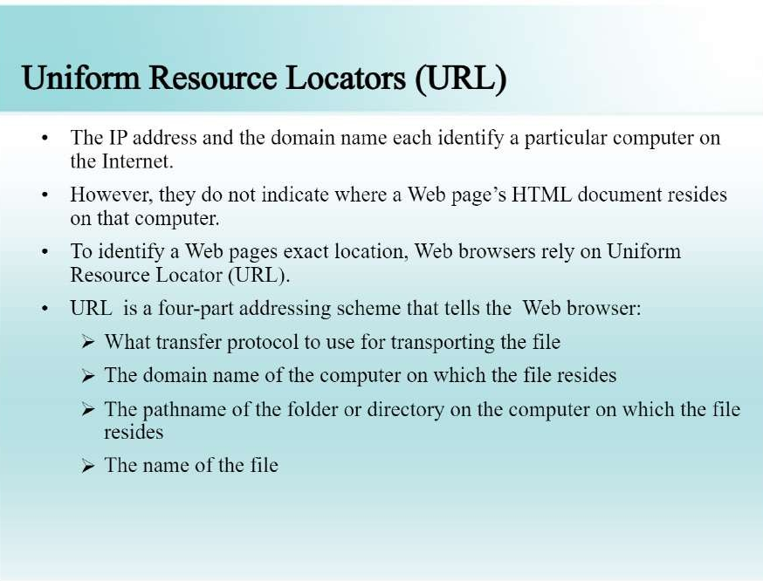

Slide 22
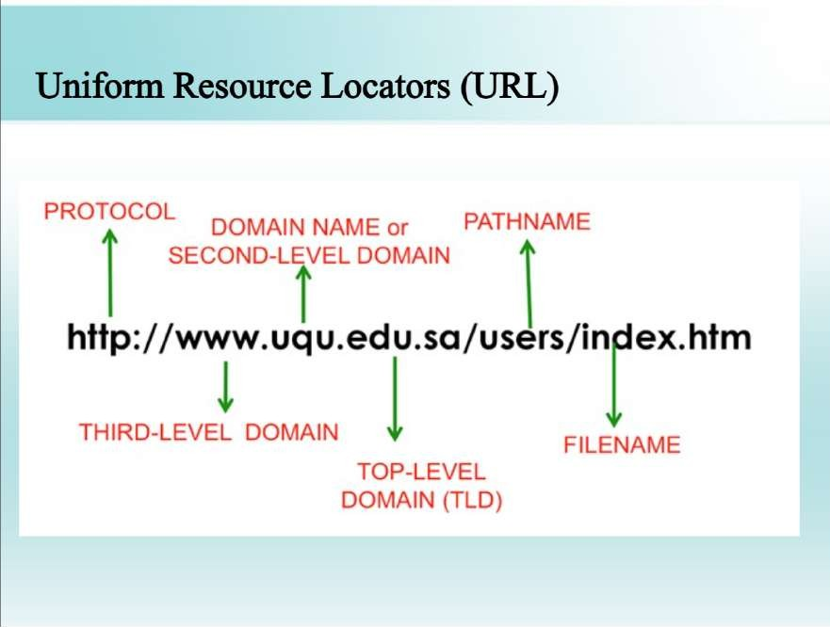

Slide 23
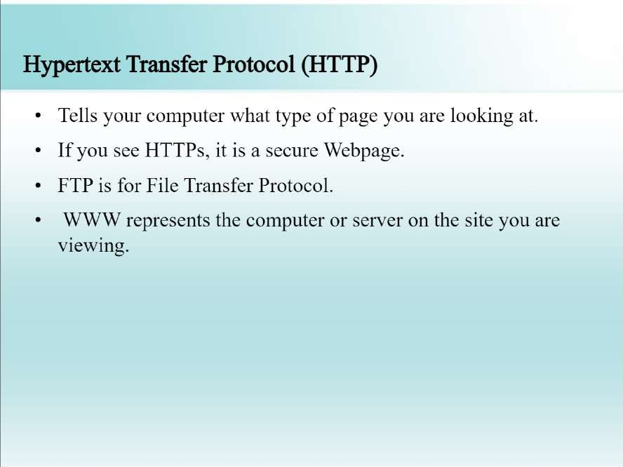

Slide 24
WWW
The World Wide Web, commonly known as the Web, is a system of interlinked hypertext/hypermedia documents accessed via the Internet.
Hypertext is text displayed on a computer or other electronic device with references to other text that the reader can immediately access, usually by a mouse click or key press sequence.
Hypermedia is used as a logical extension of the term hypertext in which graphics, audio, video, plain text and hyperlinks intertwine to create a generally non- linear medium of information.
Creator: Timm Berners-Lee, 1989.

Slide 25

Tim Berners-Lee
Father of W W W.
Invented WWW while working at CERN, the European Particle Physics Laboratory

Slide 26
Difference b/w the Web and Internet
Internet = collection of networks that connect millions of businesses, government agencies, educational institutions, and individuals.
WWW = the means we use to access information over the internet
Different communication protocols
Special link (hyperlink) that enable users to jump from one place to another on the web.

Slide 27
Web Page
A web page is a document or resource of information that is suitable for the World Wide Web and can be accessed through a web browser and displayed on a monitor or mobile device.
This information is usually in HTML or XHTML format, and may provide navigation to other webpages via hypertext links.
It can contain text, graphics, audio, video and has built- in connection or links to other web documents.
A web page has a unique address called a Uniform Resource Locator (URL).

Slide 28
Web Browser
A software application for retrieving, presenting, and traversing information resources on the World Wide Web.
It allows to locate, view, and navigate the web.
It can have a Graphical User Interface, meaning they can display pictures (graphics) in addition to text and other forms of multimedia such as sound and video like Internet Explorer, Mozilla Firefox, Chrome and Opera, or can be text-based, like Lynx or Links.
First web browser was develop in 1991: Mosaic develop by Marc Andreessen.

Slide 29


Slide 30
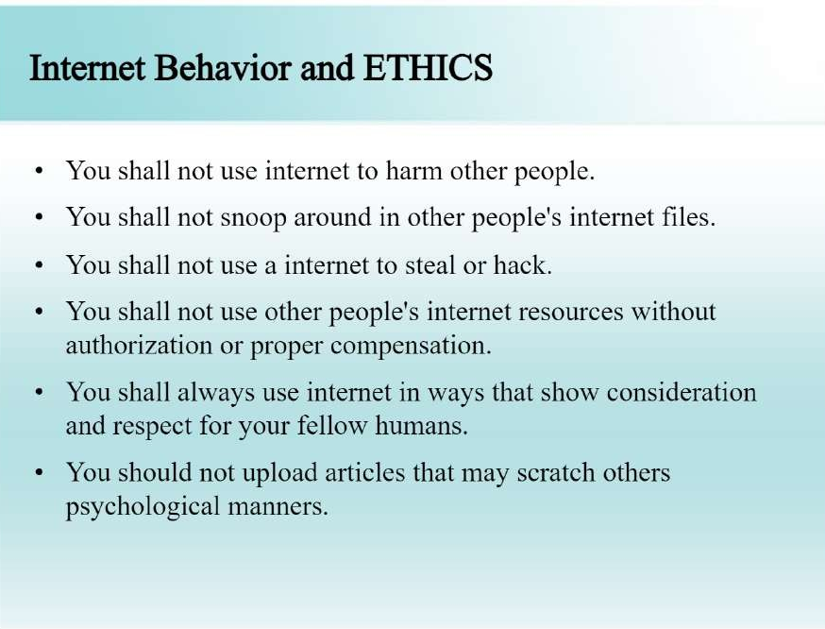

Slide 31
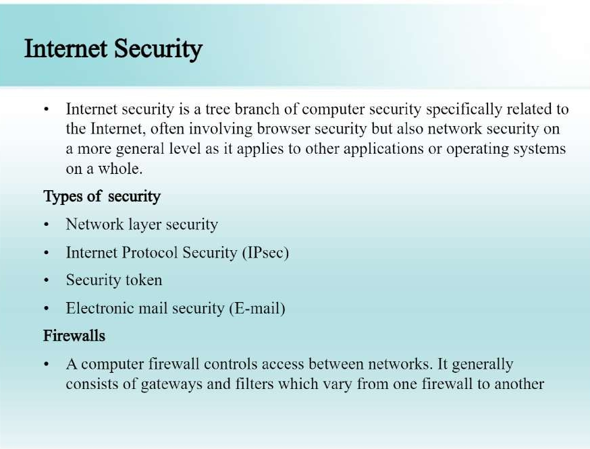

Slide 32
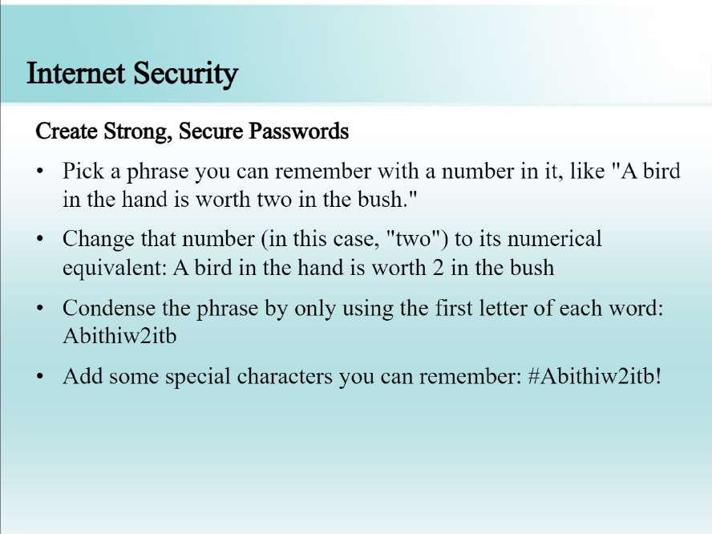

Slide 33
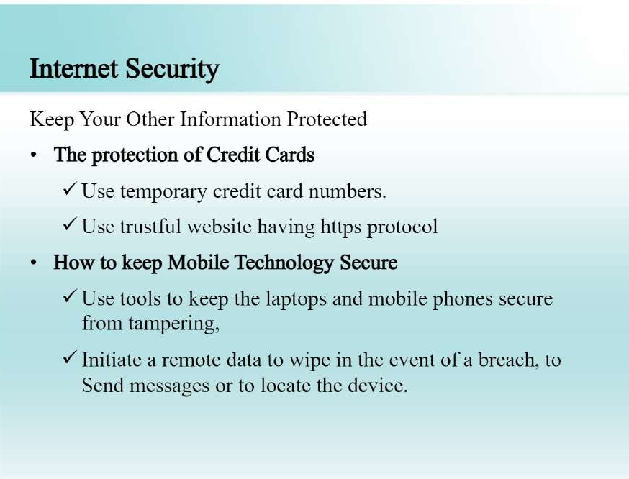

Slide 34
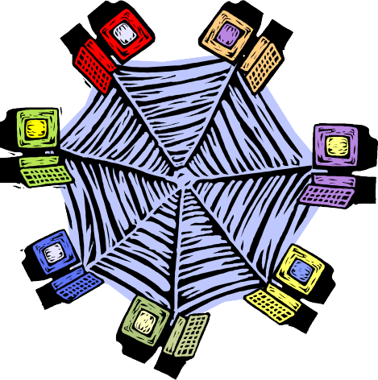
Client Server Architecture
A network architecture in which each computer or process on the network is either a client or a server.

Slide 35

Components
Clients
Servers
Communication Networks
Server
Client

Slide 36
Clients
Applications that run on computers
Rely on servers for
Files
Devices
Processing power
Example: E-mail client
Clients are Applications
An application that enables you to send and receive e-mail

Slide 37
Servers
Computers or processes that manage network resources
Disk drives (file servers)
Printers (print servers)
Servers Manage Resources
Network traffic (network servers)
Example: Database Server
A computer system that processes database queries

Slide 38





Communication Networks
Networks Connect Clients and Servers

Slide 39
Client–Server Computing
Process takes place
on the server and
on the client
Servers
Store and protect data
Client-Server Computing Optimizes Computing Resources
Process requests from clients
Clients
Make requests
Format data on the desktop

Slide 40
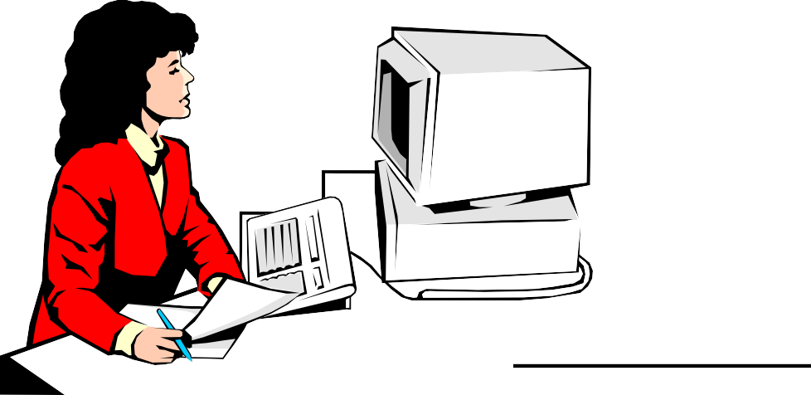
Application Functions
Software application functions are separated into three distinct parts
Server: Data Management
Client: Presentation & Application Logic

Slide 41
Application Components
3
2
1
Data Management
Application Logic
Presentation
2 Client Types
Fat Client
Thin Client
3 Logical Tiers
Database Applications:
Most common use of client-server architectures

Slide 42
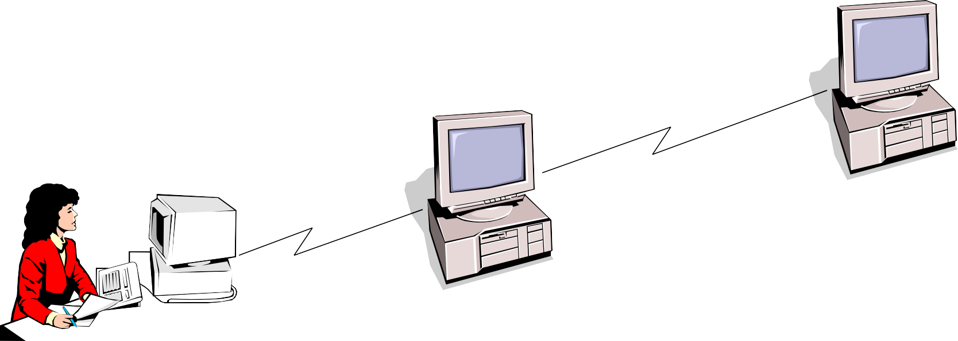
Middleware
Software that connects two otherwise separate applications
Example: Middleware product linking a database system to a web server
Database Server:
Manages Data
Middleware Links Applications
Web Server:
Presents Dynamic Pages
Client: Requests Data via Web

Slide 43
Types of Servers
From A to Z
Application Servers
Audio/Video Servers
Chat Servers
Fax Servers
FTP Servers
Groupware Servers
IRC Servers
List Servers
Mail Servers
News Servers
Proxy Servers
Telnet Servers
Web Servers
Z39.50 Servers
Source: http://webopedia.lycos.com

Slide 44
Advantages
Improved Data Sharing
Integration of Services
Shared Resources amongst Different Platforms
Inter-Operation of Data
Data Processing capability despite the location
Easy maintenance
Security

Slide 45
Disadvantages
Overloaded servers
Impact of centralized architecture

Slide 46
What is Internet?
is a Global network of computers which may be server or client that exchanges information.
It can be defined as a "network of networks" which can be linked through copper wires, wireless connections, and other technologies.
This is the world-wide network of computers accessible to anyone who knows their Internet Protocol (IP) address.

Slide 47
What is Intranet?
The term Intranet is derived from two words: ‘Intra’ which means within and
‘net’ which means group of interconnected computers.
is a private computer network that uses Internet protocols and network connectivity to securely share any part of an organization's information or operational systems with its employees.
In short, an intranet is private network,

Slide 48
How it is different from Internet?
The technologies used in Intranet and Internet may be same but the main difference between them is that the information shared in intranet can be access only by authorized persons especially members or employees of the organization or company where as in internet the information is shared world wide with any public user to explain in simple terms, intranet is private, within the organization while internet is public available for global access

Slide 49
Benefits of intranets
Workforce productivity:
Intranets can help users to locate and view information faster and use app. relevant to their roles and responsibilities. With the help of a web browser interface, users can access data held in any database the organization wants to make available, anytime and - subject to security provisions – from anywhere within the company workstations, increasing employees' ability to perform their jobs faster, more accurately, and with confidence that they have the right information. It also helps to improve the services provided to the users.
Time:

Slide 50
Communication:
Intranets can serve as powerful tools for communication within an organization, vertically and horizontally. From a communications standpoint, intranets are useful to communicate strategic initiatives that have a global reach throughout the organization.
The type of information that can easily be conveyed is the purpose of the initiative and what the initiative is aiming to achieve, who is driving the initiative, results achieved to date, and who to speak to for more information. By providing this information on the intranet, staff has the opportunity to keep up-to-date with the strategic focus of the organization.
Cost-effective:
Most organizations have already established TCP/IP networks, and the incremental infrastructure cost of adding Web servers to the network is well within even

Slide 51
Low maintenance
With information residing in only one place - the Web server - it is relatively easy and affordable to add new information or to update existing information and make it instantly available.

Slide 52
What is Extranet?
is an intranet for outside authorized users using same internet technologies. The outside users are trusted partners of the organization who have access to information of their interest & concern.
extends the intranet concept to provide a network that connects a company’s network to the networks of its business partners, selected customers, or suppliers.

Slide 53
An extranet is a web portal that is accessible by an organization and its external vendors, partners, customers, or any other users that require access to restricted information.
With an extranet, the host organization manages the site administration and content, and provides controlled access to internal and external members. Some example use cases for an extranet include a partner or vendor portal, a customer community, or a franchise network.

Slide 54
How it is different from Intranets?
Intranets differ from extranet in that the former are generally restricted to employees of the organization while extranets may also be accessed by customers, suppliers, or other approved parties. Extranets extend a private network onto the Internet with special provisions for access, authorization and authentication.

Slide 55
Types of Extranet
Public Network Extranet
exists when an organization allows the public to access its intranet from any public network. Security is an issue in this configuration, because a public network does not provide any security protection.
Private Network Extranet
Is a private, leased-line connection bet. Two companies that physically connects their intranets to one another. The single advantage of this is Security. The single largest drawback is Cost.
Virtual Private Network (VPN)
is a network that uses public networks and their protocols to send sensitive data to partners, customers,

Slide 56
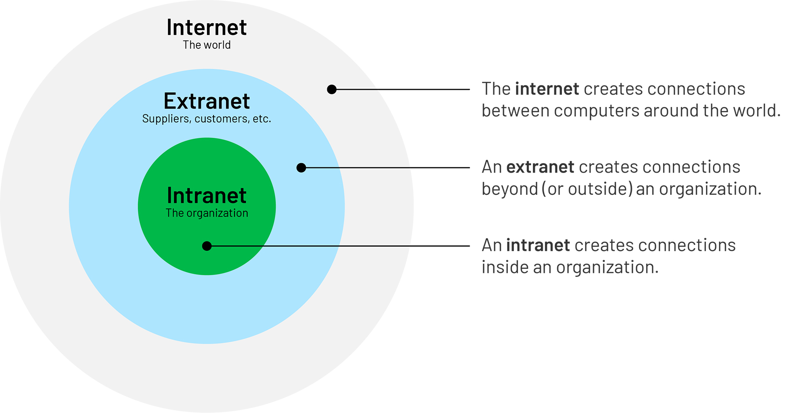

Slide 57
Uses of Network
It is Used for
Business Application
Home Application
Mobile Users
E-Mail

Slide 58
Categories or Types of Network
There are Three Types:
LAN - Local Area Network
MAN - Metropolitan Area Network
WAN – Wide Area Network

Slide 59
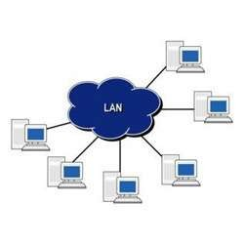
LAN - Local Area Network
A LAN is Designed by Local Area Connections such as:
within Building
within office
within Campus
within Specific Place

Slide 60
Advantages :
Sharing of Files.
Sharing of Programs.
Communication Exchange.
Disadvantages :
Reliability.
Capacity.
High Cost.

Slide 61
2. MAN - Metropolitan Area Network
A Metropolitan Area Network (MAN) is a network that interconnects users with computer resources in a geographic area or region larger than that covered by even a large local area network (LAN) but smaller than the area covered by a wide area network (WAN).

Slide 62
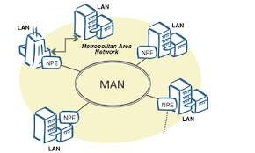
MAN supports up to 150 Kilometers Distance.
Example:
→ Telephone Network
→ Cable TV

Slide 63
Advantages :
High Bandwidth.
It support Large number of Clients.
Reduce the Errors.
Disadvantages :
Large Space Requirements.
Slower Data Access.
High Cost.

Slide 64
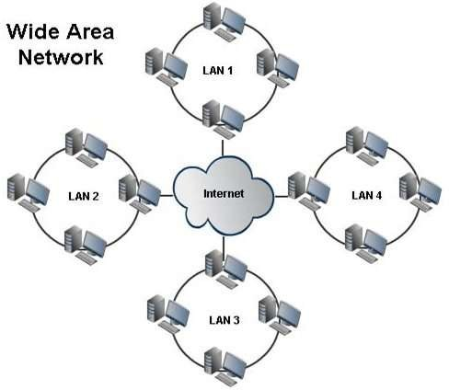
3. WAN – Wide Area Network
WAN Provide a Long Distance Transmission of Data.
By Using WAN Exchange the Information from one country to another country.

Slide 65









Components of Network
- Which gives the Request.
- Which gives the Response.
- It Indicates Modulator / Demodulator.
- Which identifies the Path between Client
& Server.
- Which overcomes the Traffic
problems.

Slide 66
Communication Model
Data communications are exchange of data between two devices via some transmission medium.
It should be done in two ways
Local - It takes LAN Connection.
Remote - It takes Long distance like MAN & WAN.
Data should be Transferred in the form of
0’s and 1’s

Slide 67
Source
Transmission Medium
Destination
Delivery - The System must deliver the data to the correct Destination.
Accuracy - The System must deliver the data at Accurate way.

Slide 68


Timeline - The System must deliver the data at Exact Time.
Jitter - It refers to the variable in the
Sender
Receiver
Medium
Message
Protocol

Slide 69
5. Protocol Step : 1 Step : 2
5. Protocol Step : 1 Step : 2
4. Message
2. Receiver
1. Sender
3. Medium

Slide 70









: It is a device , that Sends the information to the Receiver.
: It is a device , that Receives the information from the Sender.
: It is the physical path between Sender to Receiver.
: This is the passing Informations.
: It is a set of rules and regulations that “ Governed “ from data communication.

Slide 71

Data Transmission occurs between sender and receiver over some Transmission Medium or Transmission Media.
Transmission Media may be classified into Two Types :
Guided Media [Wired Technology]
Unguided Media [Wireless Technology]

Slide 72
i) Guided Media (Wired Network)
In Guided Media Signals are Passed in a “ same physical path”
Example:
Twisted pair Cable
Coaxial Cable
Fiber Optic Cable

Slide 73
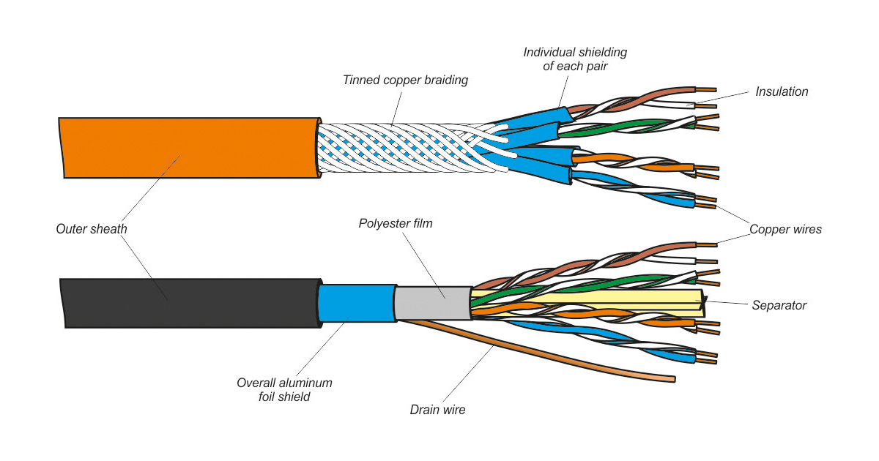

Slide 74
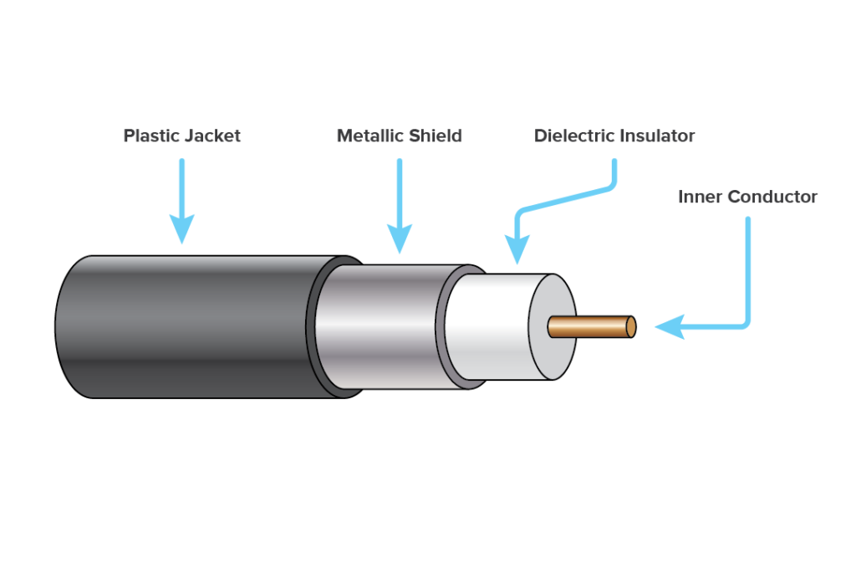

Slide 75
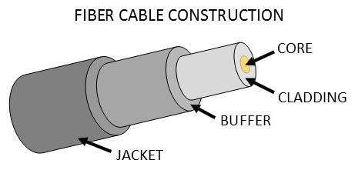

Slide 76
ii) Unguided Media (Wireless Network)
In Unguided Media Signals are Passed in the form of “ Electromagnetic Waves”
Example :
Mobile phones
Satellite microwave
Infrared

Slide 77




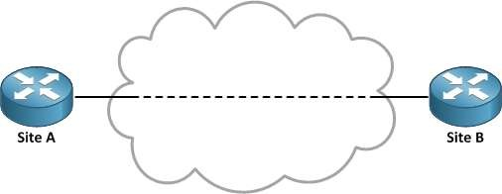
It Provides a dedicated links between two devices.
For example, a wired system that connects two computers together can be thought of a point- to-point link.

Slide 78





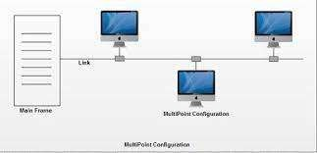
It is a link between two or more devices. It is also known as Multi- Point configuration. The networks having multipoint configuration are called

Slide 79
Transmission Mode
It refers to the direction of information flow between two devices.
Data flow is the flow of data between 2 points.
The direction of the data flow can be described as
Simplex Mode
Half-Duplex Mode
Full-Duplex Mode

Slide 80
Simplex: Data flows in only one direction on the data communication line (medium).
Examples are Radio and Television broadcasts.
Half-Duplex: Data flows in both directions but only one direction at a time on the data communication line.
Ex. Conversation on walkie-talkies.
Full-Duplex: Data flows in both directions simultaneously. Modems are configured to flow data in both directions.
Ex. Phone Conversation

Slide 81
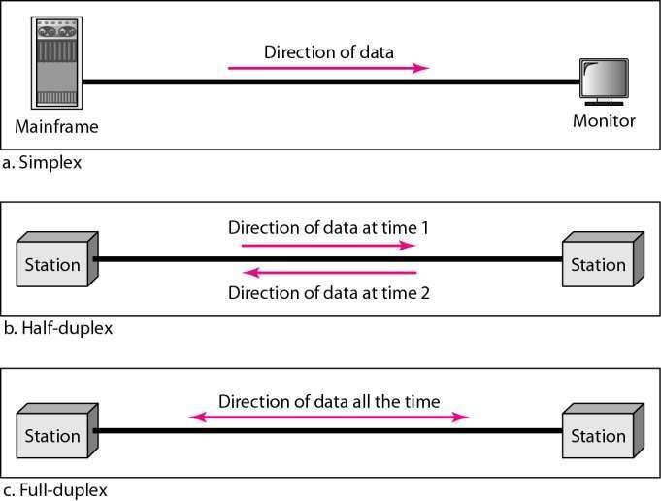
Data Flow
Figure 1.2 Data flow (simplex, half-duplex, and full-duplex)

Slide 82
Protocol Architecture
It is a layered structure of H/W and S/W that
data b/w systems
It supports distributed applications(E-Mail,
supports exchange of
File Transfer)
Each layer of protocol architecture provides some set of rules
There are 2 widely used protocol architecture
TCP/IP Architecture
OSI Model

Slide 83
Protocol
Protocol is a set of rules that govern data communication
It represents what is communicated, when it is communicated and how it is communicated.
There are 3 key elements
Syntax
Semantics
Timing

Slide 84
Syntax
It represents structure, Format of data the order in which it is presented
Data may contain:
First 8 bit -> Sender Address
Second 8 bit -> Receiver Address
Remaining bits-> message stream

Slide 85
SEMANTICS
It refers the meaning of each section of bit
TIMING
It refers when data sent and how fast it is sent (Says Characteristics)
Ex:100Mbps

Slide 86


It provides model for the development of product regardless of individual manufacturer
It falls in 2 categories

Slide 87
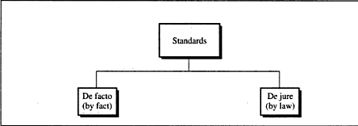

Slide 88
De Facto standard
Not officially adopted but used widespread
It has 2 categories
Proprietary->Wholly owned by company
Non-Proprietary->Group or communiy developed for public

Slide 89
De Jure Standard
A Standard Legislated by an officially recognized body
Standard Organizations:
International Standard Organization
ANSI
IEEE

Slide 90
The OSI Model
An ISO (International standard Organization) that covers all aspects of network communications is the Open System Interconnection (OSI) model.
An open system is a model that allows any two different systems to communicate regardless of their underlying architecture (hardware or software).
The OSI model is not a protocol; it is model for understanding and designing a network architecture that is flexible, robust and interoperable.

Slide 91
The OSI model is a layered framework for the design of network systems that allows for communication across all types of computer systems.
The OSI model is built of seven ordered layers:
(Layer 1) Physical layer
(Layer 2) Data link layer
(Layer 3) Network layer
(Layer 4) Transport layer
(Layer 5) Session layer
(Layer 6) Presentation layer
(Layer 7) Application layer

Slide 92
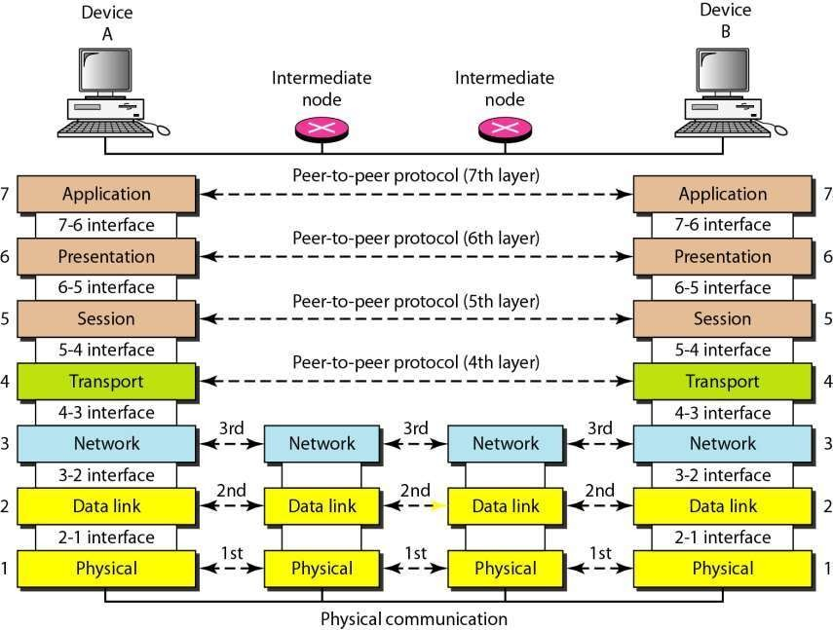

Slide 93
Peer-to-Peer Process
Within a single machine, each layer calls upon services of the layer just below it.
Layer 3, for example, uses the services provided by layer 2 and provides services for layer 4.
Between machines, layer x on one machine communicates with layer x on another machine, by using a protocol (this is Peer-to-Peer Process).
Communication between machines is therefore a peer-to- peer process using protocols appropriate to a given layer.

Slide 94
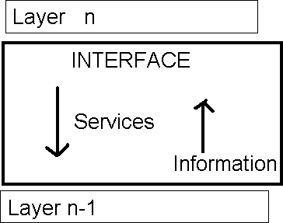
Interfaces between Layers
There is an interface between each pair of adjacent layers. This interface defines what
information and services a layer must for the layer above it.
provide

Slide 95
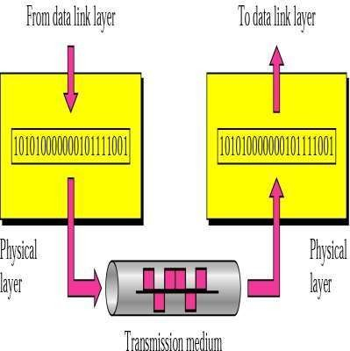
Functions of Layers
1. Physical Layer
The physical layer is responsible for transmitting
individual bits from one node to the next.

Slide 96
Physical layer
The physical layer is concerned with the following:
Physical characteristics of interfaces and media: It define the type of transmission media
Representation of the bits: the physical layer data consist of a stream of bits(0,1). The transmitted bits must be encoded into signals – electrical or optical. The physical layer defines the type of encoding.
Data rate: The physical layer defines the transmission rate, the number of bits sent each second.

Slide 97
Physical Layer
Line configuration: the physical layer is concerned with the connection of devices to the medium.
Physical topology – Ring, star
Transmission Mode - Simplex, Half duplex Full Duplex

Slide 98
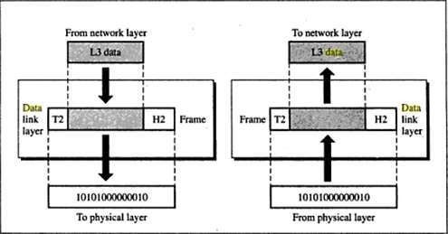
2. Data Link Layer
It is responsible for node-to-node delivery of data.

Slide 99
Functions of the Data Link Layer:
Framing. The data link layer divides the stream of bits received from the network layer into data units called frames.
Physical addressing. If frames are to be distributed to different systems on the network, the data link layer adds a header to the frame to define the physical address of the sender (source address) and/or receiver (destination address) of the frame.
If the frame is intended for a system outside the sender’s network, the receiver address is the address of the device that connects one network to the next.

Slide 100
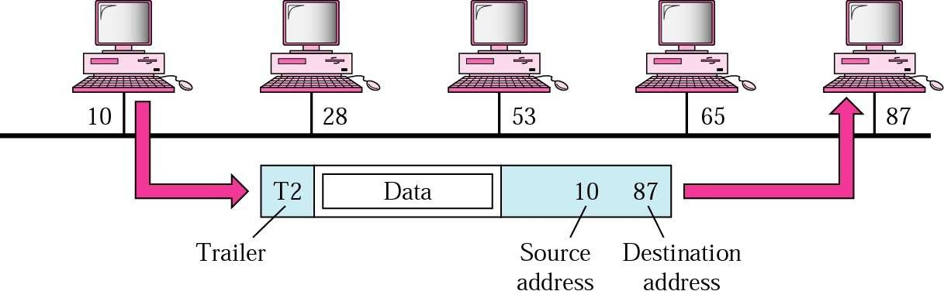

Slide 101
Flow Control. If the rate at which the data are absorbed by the receiver is less than the rate produced in the sender, the data link layer imposes a flow control mechanism to prevent overwhelming the receiver.
Error control. The data link layer adds reliability to the
physical layer by adding mechanisms to retransmit damaged or lost frames. Error
detect and control is
normally achieved through a trailer to the end of the frame.
Access Control. When two or more devices are connected to the same link, data link layer protocols are necessary to determine which device has control over the link at any time.

Slide 102
3. Network Layer
The Network layer is responsible for the source-to- destination
delivery of a packet possible across multiple networks.
It converts Frames into packets.
If two systems are connected to the same link, there is usually no need for a network layer. However, if the two systems are attached to different networks, there is often a need for the network layer to accomplish source-to-destination delivery.

Slide 103
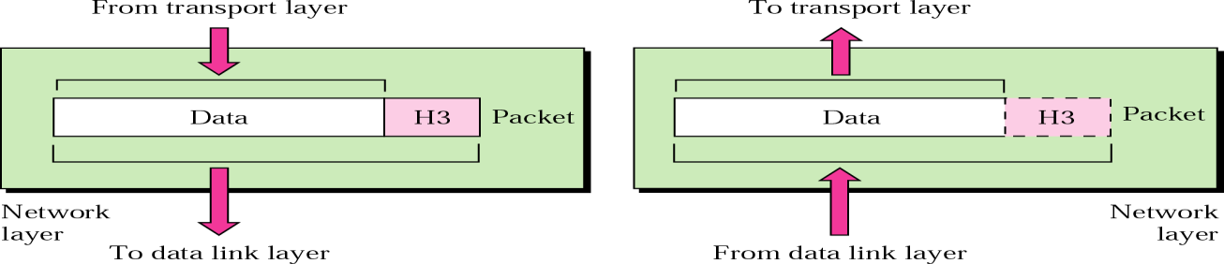
Network Layer
Functions:
Logical addressing-Physical addressing (May change) handle
addressing problem locally
If packet pass the network boundary, we need another addressing
called logical addressing (Never change)
Routing - Route the packet to final destination
The network layer is responsible for the delivery of packets from the original
source to the final destination.

Slide 104
4. Transport Layer
The transport layer is responsible for process-to-process or end-end delivery of the entire message.
The network layer oversees host-to-destination delivery of individual packets, it does not recognize any relationship between those packets.
The transport layer ensures that the whole message arrives intact and in order, overseeing both error control and flow control at the process-to-process level.

Slide 105
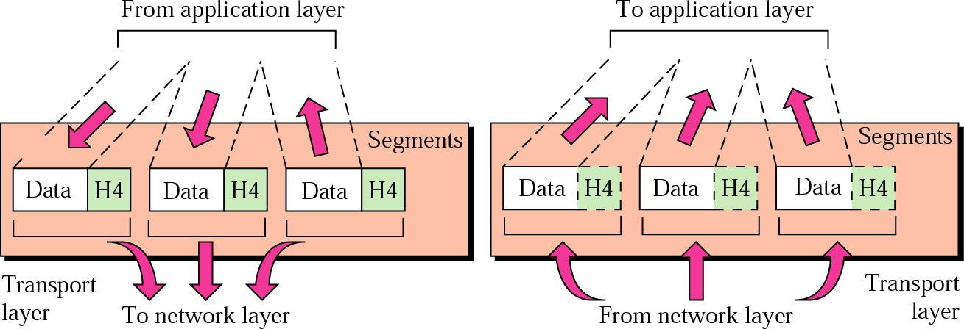
Transport layer
The transport layer is responsible for delivery of a message from one process to another.

Slide 106
Functions of the Transport layer
Service point addressing:
Computer often run several processes (running programs) at the same time. Process-to-process delivery means delivery from a specific process on one computer to a specific process on the other.
The transport layer header include a type of address called port address.
The network layer gets each packet to the correct computer; the transport layer gets the entire message to the correct process on that computer.

Slide 107
Cont..
,
Segmentation and reassembly: a message is divided into transmittable segments, each having a sequence number. These numbers enable the transport layer to reassemble the message correctly upon arrival at the destination.
Connection control: The transport layer can be either connectionless or connection-oriented.
A connectionless transport layer treats each segment as an independent packet and delivers it to the transport layer at the destination machine.
A connection-oriented transport layer makes a connection with the transport layer at the destination machine first before delivering the packets. After all the data are transferred, the connection is terminated.

Slide 108
Functions of the transport layer
Flow control: the transport layer performs a flow control end to end. The data link layer performs flow control across a single link.
Error control: the transport layer performs error control end to end. The data link layer performs control across a single link.
Congestion control concerns controlling traffic entry into a telecommunication networks so as to avoid congestive collapse by attempting to avoid oversubscription of any of the processing or link capabilities of the intermediate nodes and networks and taking resource reducing steps, such as reducing the rate of sending packets. It should not be confused with flow control, which prevents the sender from overwhelming the receiver.

Slide 109
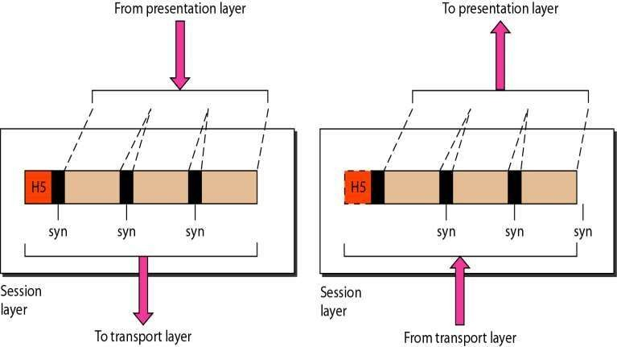
5. Session Layer
The session layer is responsible for dialog control and synchronization.

Slide 110
Functions of Session Layer
Decision Control:- Half duplex, Full Duplex
Synchronization: Adding checkpoints to stream data.
Ex: System sending 2000 pages.
Add check point after each 100th page.
So in case of failure no need to sent whole page.

Slide 111
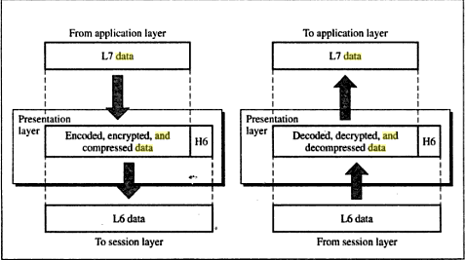
6. Presentation Layer
It is concerned with the syntax and semantics of the information exchanged b/w 2 devices.

Slide 112
Functions of Presentation Layer
Translation: Interoperability b/w different encoding formats.
Encryption: Converting plain to cipher text and vice versa.
Compression: Reducing number of bits in multimedia data when transmitting.

Slide 113
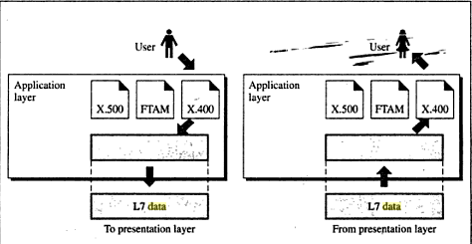
7. Application layer
The application layer is responsible for providing services to the user.

Slide 114
Functions of Application Layer
It provides user access to network.
X.500-Directory service.
X.400-Message handling service.
FTAM- File Transfer management.
Network Virtual Terminal.
Access and

Slide 115


Transmission Control Protocol / Internetworking Protocol is used in the internet and is developed prior to the OSI model.
It would not match exactly with OSI model
It is divided into layers.

Slide 116
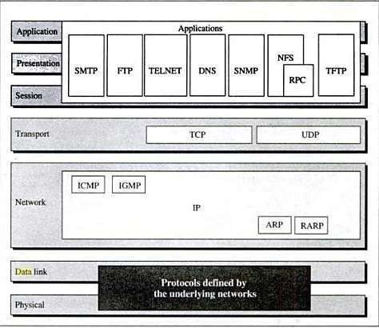
TCP/IP protocol

Slide 117
It contains relatively independent protocols that can mixed and matched with depend on needs of the system.

Slide 118


It defines the Physical (or) Logical arrangement of Links in a Network.
Topology refers to the layout of connected devices in a network.
The Topology of the Network is Geometric Representation of the relationship between all Communication links.

Slide 119
Types of Topology
Mesh Topology
Star Topology
Tree Topology
Bus Topology
Ring Topology
Hybrid Topology

Slide 120


Types of Topology
Here every device has a direct point to point link between every other device.
A fully connected mesh can have n(n-1)/2 physical channels to link n devices.
if n=5 (Number of Nodes)
5(5-1)/2 = 10 ( Communication Links)
5 Nodes are Connected by using 10 Communication Links

Slide 121
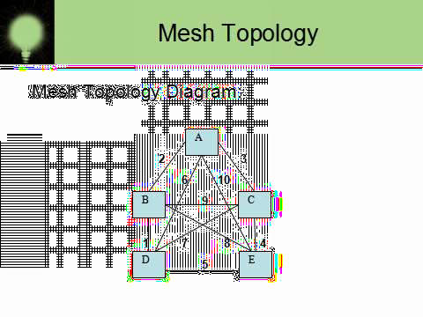
Mesh Topology

Slide 122
Mesh Topology
Advantages:
It eliminate the traffic problem.
It is robustness.
It has privacy and security.
Fault can be easily found.

Slide 123
Mesh Topology
Disadvantages:
More number of cables to be used.
Every devices must be connected to some other devices. So installation process is very difficult.

Slide 124


Types of Topology
Each device has a dedicated point-to-point link between only a central controller or “HUB”.
The devices are not directly linked to some other devices.
If one device wants to send data to another device, it sends to the central controller and the Central controller send to other device.

Slide 125
Star Topology
Star Topology Diagram:
A
B
Central controller
(or)
HUB
C
D

Slide 126
Star Topology
Advantages :
Less expensive than Mess topology.
Less number of cables to be used.
It is robustness.

Slide 127
Star Topology
Disadvantages:
Each device must connected to controller.
It require more installation process.
If central controller failure means devices should be failed.
central
all the

Slide 128


Types of Topology
Tree topology has some variation from star topology.
The nodes in the tree are linked to the central controller.
The primary HUB in the tree is represented by “Active Hub”.
The secondary HUB in the tree is represented by “Passive Hub”.

Slide 129

Tree Topology

Slide 130
Tree Topology
Advantages:
It allows more devices to be attached in a single central controller.
It allows the network to prioritize the communication.

Slide 131
Tree Topology
Disadvantages:
Each device must be linked to controller.
It require more installation processes.
If central controller failure means system should fail down.
central
entire

Slide 132


Types of Topology
A Bus topology describes the multipoint configuration.
One long cable act as a backbone to link all the devices in a network.
Devices are connected in a bus topology with the help of “Drop lines” and “Tapes”.

Slide 133
Bus Topology
Bus Topology Diagram:
A
B
C
D
Back bone
bone
Drop line
Drop line
Tape
Back

Slide 134
Bus Topology
Advantages:
Installation process is very easy.
Redundancy can be eliminated.
Less number of cables to be used.

Slide 135
Bus Topology
Disadvantages:
Reconfiguration is very difficult.
Very difficult to adding (or) deleting of a devices

Slide 136



Types of Topology
In Ring Topology each device has dedicated point-to-point link between other devices.
The signals are passed along the “ring” in only one direction from device to device.
Each devices in a ring should have a “Repeater”.

Slide 137
Ring Topology
Ring Topology Diagram:
A
D
Ring
B
C

Slide 138
Ring Topology
Advantages:
Easy to install and reconfigure.
Fault can be easily identified.

Slide 139
Ring Topology
Disadvantages:
It is unidirectional traffic.
In rings if one device gets failure then the entire system should be failed.

Slide 140
VI. Hybrid Topology
Combination of all topology is called hybrid topology.

Slide 141


Slide 142


The physical path between transmitter and receiver.
Repeaters or amplifiers may be used to extend the length of the medium.
Communication of electromagnetic waves is guided or unguided.

Slide 143


Slide 144


Slide 145


Slide 146

Twisted-pair cable

Slide 147


UTP and STP

Slide 148


Slide 149


Slide 150


Slide 151


Slide 152


Slide 153


Coaxial Cable

Slide 154














BNC connectors
To connect coaxial cable to devices, it is necessary to use coaxial connectors. The most common type of connector is the Bayone-Neill- Concelman, or BNC, connectors.
Applications include cable TV networks, and some traditional
Ethernet LANs like 10Base-2, or 10-Base5.

Slide 155


Slide 156


Slide 157

Optical fibers

Slide 158

Propagation Modes (Types of Optical Fiber )

Slide 159

Propagation Modes

Slide 160


Slide 161


Slide 162


Slide 163


Slide 164


Slide 165


Slide 166


Slide 167


Slide 168


Slide 169


Slide 170


Slide 171


Slide 172


Slide 173


Slide 174


Slide 175


Slide 176

THANK YOU

Slide 177
UNIT II DATA LINK LAYER
Data link control – Error Detection – VRC
– LRC – CRC – Checksum – Error Correction – Hamming Codes – MAC – Ethernet, Token ring , Token Bus – Wireless LAN - Bluetooth – Bridges.

Slide 178
UNIT – II
DATA LINK LAYER

Slide 179
OVERVIEW
Data Link Control
Error Detection
VRC
LRC
CRC
Checksum
Error Correction
Hamming Codes
MAC
Ethernet
Token ring
Token Bus
Wireless LAN
Bluetooth
Bridges

Slide 180

Data Link Control
Communication
Minimum 2 devices are needed for data communication. So line discipline is necessary for co-operation b/w 2 devices.
The 2 important functions of data link layer is flow control and error control.This functions are otherwise called as Data link control.

Slide 181

Line Discipline
It coordinates the link system
It is done in 2 ways
ENQ (Enquiry)
Used in peer – peer communication
Enquire whether there is a required link b/w
two devices
Check whether the intended device is capable to receive
ACK (Acknowledgment)
Used in Primary secondary communication
The intended device will acknowledge about its status to the
receiver

Slide 182

There are 2 categories in line discipline

Slide 183

ENQ /ACK Line Discipline

Slide 184


Select
It is a line discipline used in topologies
with primary secondary relationship.
Select
It is uses whenever the primary device
has something to send.ie)Primary controls the link.

Slide 185

Select

Slide 186

Select

Slide 187
Poll
The polling function is used by the primary device to Select transmissions from the secondary devices.
If the primary device is ready to receive data , It ask each device in turn if it has anything to send.

Slide 188

Poll

Slide 189


Flow Control
It is a set of procedures to tell the sender
how much data it can transmit before it must
wait for an acknowledgement
from the
receiver.
Two categories of flow control:
Stop-and-wait
Send one frame at a time.
Sliding window
Send several frames at a time.

Slide 190


Slide 191


Stop-and-wait
Sender sends one frame and waits for an acknowledgement before sending the next frame.

Slide 192

Stop-and-wait
Advantages:
Simplicity.
Each frame is checked and acknowledged before the next frame is sent.
Disadvantages:
Slow.
Can add significantly to the total transmission time if the distance between devices is long.
Inefficiency
Each frame is alone on the line.

Slide 193



SlidingWindow
Sender can send several frames before
needing an acknowledgement. Advantages:
The link can carry several frames at once.
Its capacity can be used efficiently.

Slide 194

Error Control

Slide 195


Slide 196

Error Detection

Slide 197

Error Detection

Slide 198



Even number of ones
–add 0
Odd number of ones
– add 1
Can detect all single-bit errors. Can detect burst errors only if the total
number of errors in each data unit is odd.

Slide 199



Increases the likelihood of detecting burst errors.
n bits LRC can detect a burst error of n bits.
Errors may be undetected if:
Have even number of errors in that position.

Slide 200





Slide 201



Slide 202






You will experience a painful sharpening from time to time, but this is required if you are to become a better pencil.

Slide 203

Error Correction

Slide 204


Redundancy Bits

Slide 205

You have the ability to correct any mistakes you might make.

Slide 206
Hamming Codes-Error correction
Hamming codes, like polynomial codes, are appended to the transmitted message
Hamming codes, unlike polynomial codes, contain the information necessary to locate a single bit error

Slide 207

Calculating the Hamming Code
The key to the Hamming Code is the use of extra parity bits to allow the
identification of a single error. Create the code word as follows:
Mark all bit positions that are powers of two as parity bits. (positions 1, 2, 4, 8, 16,
32, 64,etc.)
All other bit positions are for the data to be encoded. (positions 3, 5, 6, 7, 9, 10, 11, 12, 13, 14, 15, 17, etc.)
Each parity bit calculates the parity for some of the bits in the code word.The
position of the parity bit determines the sequence of bits that it alternately
checks and skips.
Position 1: check 1 bit, skip 1 bit, check 1 bit, skip 1 bit, etc.(1,3,5,7,9,11,13,15,...)
Position 2: check 2 bits, skip 2 bits, check 2 bits, skip 2 bits,etc.
(2,3,6,7,10,11,14,15,...)
Position 4: check 4 bits, skip 4 bits, check 4 bits, skip 4 bits,etc.
(4,5,6,7,12,13,14,15,20,21,22,23,...)
Position 8: check 8 bits, skip 8 bits, check 8 bits, skip 8bits, etc. (8-15,24-31,40-
47,...)
Position 16: check 16 bits,skip 16 bits,check 16 bits, skip 16 bits, etc.(16-31,48-
63,80-95,...)
Position 32: check 32 bits,skip 32 bits,check 32 bits, skip 32 bits,etc.(32-63,96-
127,160-191,...)
etc.
Set a parity bit to 1 if the total number of ones in the positions it checks is odd.
Set a parity bit to 0 if the total number of ones in the positions it checks is even.

Slide 208

Position of Redundancy bit in Hamming code

Slide 209

Error

Slide 210

Error Control

Slide 211



Stop-and-Wait A R Q

Slide 212

Sliding window ARQ

Slide 213



Slide 214



Slide 215



Slide 216

MAC
IEEE has subdivided(Project 802) the data link layer into two sub layers:
Logical Link Control
Medium access control
Functions of MAC
It resolves the contention of shared media
It contains all information to move information from one place to another
It contains the physical address of next station to route packet.
MAC protocol are specific to LAN

Slide 217


The project 802 which governs internet working. Here each
subdivision is identified by a number
802.1(internetworking)
802.2(LLC)
and MAC modules
802.3(CSMA/CD)
802.4(Tokenbus)
802.5(Tokenring)

Slide 218

Figure 13.1 IEEE standard for LANs

Slide 219
MAC protocol are specific to LAN
LAN is a Local Area Network used for communication inside building
Protocols for LAN are,
Ethernet
Token Ring
Token bus
FDDI

Slide 220


















































IEEE STANDARDS
Ethernet: It is a LAN protocol that is used in Bus and Star topologiesand
implements CSMA/CD as the medium access method
Original (traditional) Ethernet developed in 1980 by three companies: Digital, Intel, Xerox (DIX).
In 1985, the Computer Society of the IEEE started a project, called Project 802, to set standards to enable intercommunication among equipment from a variety of manufacturers.
Current version is called IEEE Ethernet

Slide 221
IEEE 802.3 supports LAN standard Ethernet
IEEE802.3 defines two categories
Baseband
Broadband
Base band has five different category
10Base5 10Base2 10BaseT 1Base5 etc.,
Broad band has a category
10Broad36

Slide 222


Access Method:CSMA/CD
When multiple user access the single line ,there is a danger of signals overlapping and destroying each other(Traffic) .such an overlap is called Collisions.
To avoid this the access method used in Ethernet is carrier sense multiple access/collision detection
In CSMA any workstation wishing to transmit must listen to existing traffic on the line
If no voltage is detected ,line is considered idle
CSMA cuts down the number of collisions, but cant eliminate. Collisions still occur if both station try to listen at a time.

Slide 223

Figure 13.4 802.3 MAC frame

Slide 224


IEEE Ethernet
In IEEE 802.3 Ethernet Data link layer is split into two sublayers:
Bottom part: MAC
The frame is called IEEE 802.3
Handles framing, MAC addressing, MediumAccess control
Specific implementation for each LAN protocol
Defines CSMA/CD as the access method for Ethernet LANs
and Token passing
method for Token Ring.
Implemented in hardware
Top part: LLC (Logical Link Control)
The subframe is called IEEE 802.2
Provides error and flow control if needed
It makes the MAC sublayer transparent
Allows interconnectivity between different LANs data link layers
Used to multiplex multiple network layer protocols in the data link
layer
frame
Implemented in software

Slide 225


Ethernet Provides Unreliable, connectionless Service
Ethernet data link layer protocol provides
connectionless service to the network layer
No handshaking between sending and receiving adapter.
Ethernet protocol provides Unreliable service to the
network layer :
Receiving adapter doesn’t send ACK or NAK to
sending adapter
This means stream of datagrams passed to network layer can have gaps (missing data)
Gaps will be filled if application is using reliable transport layer
protocol
Otherwise, application will see the gaps

Slide 226

Ethernet
Ethernet Frame format
FCS
FCS
Frame formats. (a) DIX Ethernet ,(b) IEEE
802.3.

Slide 227


Ethernet Frame
PREAMBLE
8 bytes with pattern 10101010 used to synchronize receiver, sender clock rates.
In IEEE 802.3, eighth byte is start of frame (10101011)
Addresses: 6 bytes (explained latter)
Type (DIX)
Indicates the type of the Network layer protocol being carried in the payload (data) field, mostly IP but others may be supported such as IP (0800), Novell IPX (8137) and AppleTalk (809B), ARP (0806) )
Allow multiple network layer protocols to be supported on a single machine
(multiplexing)
Its value starts at 0600h (=1536 in decimal)
Length (IEEE 802.3): number of bytes in the data field.
Maximum 1500 bytes (= 05DCh)
CRC: checked at receiver, if error is detected, the frame is discarded
CRC-32
Data: carries data encapsulated from the upper-layer protocols
Pad: Zeros are added to the data field to make the minimum data length = 46 bytes

Slide 228

Ethernet address
Six bytes = 48 bits
Flat address not hierarchical
Burned into the NIC ROM
First three bytes from left specify the vendor. Cisco 00-00- 0C, 3Com 02-60-8C and the last 24 bit should be created uniquely by the company
Destination Address can be:
Unicast: second digit from left is even (one recipient)
Multicast: Second digit from left is odd (group of stations
to receive the frame – conferencing applications)
Broadcast (ALL ones) (all stations receive the frame)
Source address is always Unicast

Slide 229

Figure 13.3 Ethernet evolution through four generations

Slide 230



Categories of traditional Ethernet
<data rate><Signaling method><Max segment length or cable type>

Slide 231
IEEE 802.3 Cable Types
Name | Cable Max. | Max Cable Segment Length | Nodes /segment | Toplogy
10Base5 | thick coax | 500 meters | 100 | Bus
10Base2 | thin coax | 185 meters | 30 | Bus
10BaseT | twisted pair | 100 meters | 1 | Star
10BaseF | Fiber Optic | 2Km | 1 | Star

Slide 232

Figure 13.10 10Base5 implementation

Slide 233



Connection of stations to the medium using 10Base2

Slide 234

10BaseT
Uses twisted pair Cat3 cable
Star-wire topology
A hub functions as a repeater with additional functions
Fewer cable problems, easier to troubleshoot than coax
Cable length at most 100 meters

Slide 235

Figure 13.12 10Base-T implementation

Slide 236

Figure 13.13 10Base-F implementation

Slide 237

Fast Ethernet
100 Mbps transmission rate
same frame format, media access, and collision detection rules as 10 Mbps Ethernet
can combine 10 Mbps Ethernet and Fast Ethernet on same network using a switch
media: twisted pair (CAT 5) or fiber optic cable (no coax)
Star-wire topology
Similar to 10BASE-T
CAT 3
CAT 5

Slide 238

Figure 13.19 Fast Ethernet topology

Slide 239

Figure 13.20 Fast Ethernet implementations

Slide 240

Gigabit Ethernet
Speed 1Gpbs
Minimum frame length is 512 bytes Operates in ful/half duplex modes mostly full duplex

Slide 241
In the full-duplex mode of Gigabit Ethernet, there is no collision;
the maximum length of the cable is determined by the signal attenuation in the cable.

Slide 242

Figure 13.23 Gigabit Ethernet implementations

Slide 243
10Gbps Ethernet
Maximum link distances cover 300 m to 40 km
Full-duplex mode only
No CSMA/CD
Uses optical fiber only

Slide 244
Token Ring
It allows each station to sent one frame
.
The access control mechanism used by Ethernet is inefficient sometimes because of collision.
It solves the collision problem by passing token
Initially a station waits for token, if a token is free the station may send a data frame

Slide 245
Cont..,
This frame proceeds around the ring ,being regenerated by each station .Each station examines the destination address finds the frame is addressed to another station and relays it to its neighbor.
The intended recipient recognizes its own address and copies the message and set the address bit
The token finally reach the sender and it recognizes that the data is delivered through address bit
Token is passed from NIC to NIC

Slide 246


Token Ring

Slide 247

Token Bus
It combines the feature of token ring and Ethernet

Slide 248
FDDI
Fiber Distributed Data Interface
local area network protocol standardized by ANSI
100-Mbps token passing
Dual-ring LAN
A high-speed backbone technology
High bandwidth
Optical fiber transmission
Allows up to 1000 stations

Slide 249

FDDI Architecture

Slide 250
Components of FDDI
Fiber optic cable
A concentrator (ring)
Stations: 2 types
DAS (Dual Attachment Station) or Class A:
Connected to both the rings
SAS (Single Attachment Station) or Class B:
Connected to primary ring

Slide 251

FDDI Frame Format
Similar to token ring frame

Slide 252
Networking and internetworking devices:
An internet is a interconnection of individual network. So to create a internet we need a internetworking devices. ie) Linking a number of LAN’s
Internet - WWW
internet-Interconnection of LAN

Slide 253
Why Interconnect?
To separate / connect one corporate division with another.
To connect two LANs with differentprotocols.
To connect a LAN to the Internet.
To break a LAN into segments to relieve traffic congestion.
To provide a security wall between two different types ofusers.

Slide 254







Connecting Devices
Internetworking
Devices
Networking Devices
Repeaters
Bridges
Routers
Gateways

Slide 255
Introduction
Many times it is necessary to connect a local area network to another local
area network or to a wide area network.
Local area network to local area network connections are usually performed
with a bridge.
Local area network to wide area network connections are usually performed
with a router.
A third device, the switch, can be used to interconnect segments of a local
area network.

Slide 256

Connecting Devices
Hub
98/
25

Slide 257
Repeater:
A repeater is a regenerator, not an amplifier
A repeater installed on a link receives the signal before it becomes too weak or corrupted ,regenerates the original bit pattern, and put the refreshed copy back onto the link.

Slide 258
Gateways:
A gateway is a protocol convertor.
It accepts a packet format for one protocol(e.g., Apple Talk) and convertsit into a packet format for another protocol(e.g.,TCP/IP).

Slide 259

A gateway
SNA network (IBM) Netware network (Novell)
104
/ 25

Slide 260
Bridges
Divide a large network into smaller segment
It filters the traffic . It contains logic(Bridge table) that allows them to keep the traffic for each segment separate.
Ie) Isolating and controlling the link problems (e.g.congestion)
Bridges have look-up table that contains physical address of every station connected to it.
105
/ 25

Slide 261



Slide 262

Bridge
108
/ 25

Slide 263


When aframe enters abridge ,itchecks the address of the destination and forward the new copy only to the segment to which the address which belongs

Slide 264
Types
Simple Multiport Transparent Remote Source routing

Slide 265
Simple Bridge
It is a less expensive type of bridge
It links 2 segments (LANS) and lists the address of all the stations in table included in each of them.
Here address must be entered manually. The table is modified when stations are added and removed.

Slide 266

Multiport Bridge
It is used to connect more than two LANS. So the bridge has 3 tables.
Here address must be entered manually
Transparent Bridge:
A transparent or learning bridge builds its table of station on its own (automatically).
The table is empty when it is installed, it builds its table when it encounters the packet for transmission. It uses the source address for building table.
It identifies the changes and update the table when system moved from one station to another

Slide 267

Multiport bridge
113
/ 25

Slide 268
Cont.,
Bridges are normally installed redundantly,that is two LANS may be connected by more than one bridge.in this cases they may create a loop.
So packet may go round and round,It can be avoided by algorithms like
Spannig tree algorithm
Source routing

Slide 269

Function of a bridge
115
/ 25

Slide 270

Remote Bridges
Data Communications and Computer Networks
A remote bridge is capable of passing a data frame from one local area network to another when the two LANs are separated by a long distance and there is a wide area network connecting the two LANs.
A remote bridge takes the frame before it leaves the first LAN and encapsulates the WAN headers and trailers.
When the packet arrives at the destination remote bridge, that bridge removes the WAN headers and trailers leaving the original frame.

Slide 271
Switches
Data Communications and Computer Networks
A switch is a combination of a hub and a bridge (multi- port bridge).
It can interconnect two or more workstations, but like a bridge, it observes traffic flow and learns.
When a frame arrives at a switch, the switch examines the destination address and forwards the frame out the one necessary connection.
Workstations that connect to a hub are on a shared
segment.
Workstations that connect to a switch are on a switched segment.

Slide 272
Wireless LANs

Slide 273


LAN/WLAN World
LANs provide connectivity for interconnecting computing resources at the local levels of an organization
Wired LANs
Limitations because of physical,hard- wired infrastructure
Wireless LANs provide
Flexibility
Portability Mobility
Ease of Installation

Slide 274


Wireless LAN Applications
Medical Professionals
Education
Temporary Situations
Airlines
Security Staff
Emergency Centers

Slide 275
IEEE 802.11 Wireless LAN Standard
In response to lacking standards, IEEE developed the first internationally recognized wireless LAN standard – IEEE 802.11
IEEE published 802.11 in 1997, after seven years of work
Scope of IEEE 802.11 is limited to Physical and Data Link Layers.

Slide 276
Benefits of 802.11 Standard
Appliance Interoperability
Fast Product Development
Stable Future Migration
Price Reductions
The 802.11 standard takes into account the following significant differences between wireless and wired LANs:
Power Management
Security
Bandwidth

Slide 277

WLAN Topology
Ad-Hoc Network
The BSS without an AP is a stand-alone network and cannot send data to other BSSs. they can locate one another and agree to be part of a BSS.

Slide 278

WLAN Topology
Infrastructure
EX: cellular network if we consider each BSS to be a cell and
each AP to be a basestation.

Slide 279

Basic service sets (BSSs)

Slide 280
StationTypes
IEEE 802.11 defines three types of stations based on their mobility in a wireless LAN:
no-transition
A station is either stationary (not moving) or moving only inside a BSS
BSS-transition
station can move from one BSS to another, but the movement is confined inside one ESS.
and ESS-transition mobility.
A station can move from one ESS to another

Slide 281

collision avoidanceCSMAICA
network allocation vector (NAV) used to avoid collision.
RTS frame includes the duration of time that it needs to occupy
the channel.
stations affected by this transmission create a timer called (NAV)
the network allocation vector (NAV) shows the time must pass before these stations allowed to check the channel for idleness.
there is no mechanism for collision detection, if the sender has not received a CTS frame from the receiver, assumes there has been a collision ,the sender tries again.

Slide 282
BLUETOOTH
Bluetooth is a wireless LAN technology designed to connect devices of different functions
such as telephones, notebooks,
computers, and so on. A
cameras, printers, coffee makers,
Bluetooth LAN is an ad hoc network, which
means that the network is formed spontaneously.
Bluetooth defines two types of networks: piconet and scatternet.

Slide 283

Piconet
A Bluetooth network is called a piconet, or a small net.
It can have up to eight stations, one of which is called the master; the rest
are called slaves.
Maximum of seven slaves. Only one master.
Slaves synchronize their clocks and hopping sequence with the master. But an additional eight slaves can stay in parked state, which means they
can be synchronized with the master but cannot take part in
communication until it is moved from the parked state.

Slide 284


Scatternet
Piconets can be combined to form what is called a scatternet.
A slave station in one piconet can become the master in
another piconet.
Bluetooth devices has a built-in short-range radio transmitter.

Slide 285
Bluetooth layers
Radio Layer: Roughly equivalent to physical layer of the Internet model.
Physical links can be synchronous or asynchronous.
Uses Frequency-hopping spread spectrum [Changing frequency of usage].
Changes it modulation frequency 1600 times per second.
Uses frequency shift keying (FSK )with Gaussian bandwidth filtering to transform bits to a signal.
Baseband layer: Roughly equivalent to MAC sublayer in LANs. Access is using Time Division (Time slots).
Length of time slot = dwell time = 625 microsec. So, during one frequency, a sender sends a frame to a slave, or a slave sends a frame to the master.
Time division duplexing TDMA (TDD-TDMA) is a kind of half-duplex communication in which the slave and receiver send and receive data, but not at the same time (half-duplex). However, the communication for each direction uses different hops, like walkie-talkies.

Slide 286

Bluetooth layers

Slide 287
Physical Links
Synchronous connection-oriented (SCO)
Latency is important than integrity.
Transmission using slots.
No retransmission.
Asynchronous connectionless link (ACL)
Integrity is important than latency.
Does like multiple-slave communication.
Retransmission is done.
L2CAP (Logical Link Control and Adaptation Protocol)
Equivalent to LLC sublayer in LANs.
Used for data exchange on ACL Link. SCO channels do not use L2CAP.
Frame format has 16-bit length [Size of data coming from upper layer in bytes],
channel ID, data and control.
Can do Multiplexing, segmentation and Reassembly, QoS [with no QoS, best- effort delivery is provided] and Group mangement [Can do like multicast group, using some kind of logical addresses].

Slide 288
THANK YOU

Slide 289
UNIT III NETWORK LAYER
Network layer – Switching concepts – Circuit switching – Packet switching – IP Addressing –IPV4, IPV6 – Routing Protocols – Distance Vector – Link State.

Slide 290
UNIT – III
NETWORK LAYER

Slide 291
Network Layer ^{OVERVIEW}
Switching Concepts
Circuit Switching
Packet Switching
Message Switching
IP Addressing
IPV4
IPV6
Routing Protocols
Distance Vector Routing
Link State Routing

Slide 292
Network Layer
The Network layer is responsible for the source-to-destination delivery of a packet possible across multiple networks.
It converts Frames into packets.

Slide 293




Source-to-Destination delivery of a packet
Logical addressing
Routing
Internetworking

Slide 294

Network layer Duties
3

Slide 295






Switching Concepts
Switches are hardware or software devices used for temporary connection b/w 2 or more devices linked to the switch in network but not to each another
Switches are needed to connect multiple devices for making one-one communication
TYPES:
•
•
•

Slide 296





Slide 297




Circuit switching
It creates direct physical connection b/w two devices such as phone or computers.
Any computer can be connected to any other using Levers.
N-by-N folded switches can connect n lines in full duplex mode.
2 types:
◦
◦

Slide 298


Slide 299






Slide 300


Space Division Switch
Path in the circuit are separated from each other
It is used both in analog and digital communication
2 Types:
Crossbar switch
Multistage switch
Crossbar Switch:
It connects n inputs to moutputs using cross points
Limitation:
More cross points needed(1000 I/P - 1000 O/P requires 1000000 crosspoints)

Slide 301


Crossbar Switch:

Slide 302


Multistage switch
Devices are linked to switches ,that are in turn linked to another switches(Hierarchy of switches)

Slide 303
Blocking:
The reduction in a number of cross points causes a phenomena called Blocking.
During heavy traffic one input cannot be connected to output because no path available

Slide 304

Time Division Switches
It uses time division multiplexing
2 methods:
Time slot interchange TDM bus
Time slot interchange:
It changes the ordering of the slot based on the desired connection
It uses RAM to store time slot Ex:
1->3 2->4 3->1 4->2
A B C D -> C D A B

Slide 305



TSI

Slide 306





Slide 307

TDM Bus- Time Division Multiplexing Here each input and output lines are connected to high speed bus
Each bus is closed during one of the four time slots

Slide 308
Limitations of Circuit Switching
It is specially designed for voice
communication(telephone). Not for data communication.
Once a circuit is established, it remains for
suitable
duration of the session. It creates
dialed(temporary)and leased(Permanent).
Less data rate because of point to connection.
point

Slide 309
Packet switching
Packet switching is better for data transmission.
Here data are transmitted through unit of variable length blocks called packets.
Longer transmission are divided multiple packets.
Packet length is decided by network.
into

Slide 310





Slide 311
DatagramApproach
In this approach a message is divided into multiple packets.
All packets choose various routes and reaches the destination.
Ordering of packets in destination is done by transport layer.

Slide 312



DatagramApproach

Slide 313

Virtual Circuit approach
It uses single route to send all packets of the message
Two formats:
Switched virtual circuit
Permanent virtual circuit
SVC
Connection is temporary
Dial-up lines
DuringTransmission.
A connection is established-all packets proper ACK- Connection is terminated
are sent –

Slide 314


Slide 315
PVC
Connection is permanent.
Circuit is dedicated for two users, No one else can use the line when communication takes place.
It always gets the same route.
Leased lines.
During Transmission.
No connection establishment or termination

Slide 316

PVC

Slide 317

Circuit switchedVs Virtual Circuit
Path Vs Route:
Circuit switched->Path Virtual Circuit->route

Slide 318
Message Switching
It uses a mechanism called store and forward
Here a message is received and stored until a appropriate route is free, then sends along.
Message switching- uses secondary storage(Disk)
Packet switching – uses primary storage(RAM)

Slide 319





Slide 320
Routers
The routers decide which route is best among many routes in a particular transmission.
Routers are like stations on the network
Routing concepts: Least cost routing:
Cheaper
Shortest path(using small number of relays or hops. Hop-count ->Number of relays

Slide 321

Non - Adaptive Routing
In some routing protocols , once a pathway to a destination is selected ,the router sends all packets in that way.
Adaptive Routing:
The router may select new route for each packet.
Packet Life Time (or)Time to Live:
The problem created by looping or bouncing is avoided by destroying the packet without looping, New packet is retransmitted

Slide 322




To route the packet with optimal cost many routing algorithms are used to Calculating the shortest path between 2 routers
Distance Vector Routing
Link State Routing

Slide 323
Distance vector Routing
Def:
Each router periodically shares its knowledge about the entire network with its neighbor.
It is represented by graph.
Key Works:
Each router shares its knowledge about the entire network to neighbors.
Routing only to the directly linked routers.
Information sharing at regular interval(each 30 seconds).

Slide 324

The Concept of Distance Vector Routing

Slide 325

2
8
1
Distance Vector Routing Table
12/28/2020
Unit-3 : Network Layer

Slide 326

Routing Table Distribution

Slide 327
Link State Routing
Def:
Each router shares its knowledge of it neighborhood with all routers in the internetwork.
It is represented by directed graph with weight.
Key work:
Each router shares its knowledge about the neighborhood
Each router sends its knowledge to all router.
Flooding -> Each router share info to neighbor, The neighbor to its own neighbor and so on.,
Information sharing when there is a change.

Slide 328

Concept of Link State Routing

Slide 329

Cost in Link State Routing

Slide 330

2
8
6
Link State Packet
12/28/2020
Unit-3 : Network Layer

Slide 331

Link State Database
2
8
7
12/28/2020
Unit-3 : Network Layer

Slide 332
TCP/IP
It was developed before OSI
This project was funded by ARPA of U.S ARPANET which is turned into TCP/IP
called
In internet it acts like a single connection many of any size and type.
TCP and UDP creates a data unit called
Segment or datagram.
network

Slide 333


Slide 334


Slide 335

What is an IP address?
An Internet Protocol address is a numerical label assigned to each device connected to a computer network that uses the Internet Protocol for communication.
An IP address serves two principal functions: host or network interface identification location addressing.

Slide 336

IP (Internet Proocol)
Network layer of TCP/IP supports IP in turn four other supporting protocol
ICMP
IGMP
ARP
RARP
It is a transmission mechanism used by TCP/IP protocols

Slide 337

IP datagram

Slide 338
C ont.,
IP Is a unreliable and connection less datagram protocol.
No error checking or tracking.
Data transmitted to destination but no guarantees.
IP must be paired with TCP.

Slide 339

IP Addressing
In addition to physical address (NIC) ,to identify each device in the network it requires IP address.
Address that identify host of its network.
An IP address is a 32-bit address. The IP addresses are unique and universal.
It Represented in a Dotted-decimal Notation.

Slide 340


Example 1
Change the following IP addresses from binary notation to dotted- decimal notation.
a. 10000001 00001011
b. 11111001 10011011
00001011 11101111
11111011 00001111
Solution
We replace each group of 8 bits with its equivalent decimal number and add dots for separation:
a. 129.11.11.239
b. 249.155.251.15

Slide 341

Example 2
Change the following IP addresses from dotted-decimal notation to binary notation.
a.
b.
111.56.45.78
75.45.34.78
Solution
We replace each decimal number with its binary equivalent (see Appendix B):
a. 01101111 00111000 00101101 01001110
b. 01001011 00101101 00100010 01001110

Slide 342


Slide 343

Figure 19.10
Finding the class in binary notation

Slide 344


Finding the class in decimal notation (changes from 0 to 255)

Slide 345
Private and Public IP Address
 | Class | Starting IPAddress | Ending IPAddress | # of Hosts
 | A | 10.0.0.0 | 10.255.255.255 | 16,777,216
 | B | 172.16.0.0 | 172.31.255.255 | 1,048,576
 | C | 192.168.0.0 | 192.168.255.255 | 65,536

Slide 346


Slide 347


Slide 348

Types of IP address
Static address Dynamic address
Static IP address
manually input by network administrator.
manageable for small networks.
requires careful checks to avoid duplication.

Slide 349
Types of IP address
Dynamic IP address examples - BOOTP, DHCP
Assigned by server when host boots
Derived automatically from a range of addresses
Duration of ‘lease’ negotiated, then address released back to server

Slide 350
Subnetting
Dividing the network into several smaller groups (subnets) with each group having its own subnet IP address.
Site looks to rest of internet like single network and routers outside the organization route the packet based on the main Network address.
Local routers route within subnetted network using subnet address.

Slide 351
Subnetting
Host portion of address partitioned into subnet number (most significant part) and host number (least significant part)
In this case, IP address will have 3 levels
(Main network, subnet, host)
Subnet mask is a 32-bit consists of zeros and ones that indicates which bits of the IP address are subnet number and which are host number
Subnet mask when AND ed with the IP address it gives the subnetwork address

Slide 352
Masking.
Masking is a process that extracts the address of the physical network from an IP address.
Boundary level masking: Here the mask numbers are either 255 or 0, finding the subnetwork address is very easy.
Non-boundary level masking.
If mask numbers are not just 255 or 0,
finding the subnetwork address involves using the bitwise AND operators

Slide 353
Supernetting:
Supernetting combines several networks into one lager one (Because of Address reduction)

Slide 354
IP Network Addressing
INTERNET → world’s largest public
data
network, doubling in size every nine months
IPv4, defines a 32-bit address -
₂32
(4,294,967,296) IPv4 addresses available
The first problem is concerned with the eventual depletion of the IP address space.
Traditional model of classful addressing does not allow the address space to be used to its maximum potential.

Slide 355

ClassfulAddressing
When IP was first standardized in Sep 1981, each system attached to the IP based Internet had to be assigned a unique 32-bit address
The 32-bit IP addressing scheme involves a two level addressing hierarchy
Network Number/Prefix
Host Number

Slide 356

Internet Protocol (IP)
What is Internet Protocol?
Internet Protocol is a set of technical rules that defines how computers communicate over a network.
Currently, There are two versions of IP
IP version 4 (IPv4) IP version 6 (IPv6).

Slide 357
Internet Protocol (IP)
What is IPv4?
IPv4 was the first version of Internet Protocol to be widely used, and accounts for most of today’s Internet traffic.
There are just over 4 billion IPv4 addresses. While that is a lot of IP addresses, it is not enough to last forever.

Slide 358
Internet Protocol (IP)
What is IPv6?
IPv6 is a newer numbering system that provides a much larger address pool than IPv4. It was deployed in 1999 and should meet the world’s IP addressing needs well into the future.

Slide 359
Internet Protocol (IP)
What is the major difference?
The major difference between IPv4 and IPv6 is the number of IP addresses.
There are 4,294,967,296 IPv4 addresses.
while, there are 340,282,366,920,938,463,463,374,607,431, 768,211,456 IPv6 addresses.

Slide 360



128-bit IPv6 Address
3FFE:085B:1F1F:0000:0000:0000:00A9:1234
8 groups of 16-bit hexadecimal numbers separated by “:”
Leading zeros can be removed
3FFE:85B:1F1F::A9:1234
:: = all zeros in one or more group of 16-bit hexadecimal numbers

Slide 361
IPv4 vs. IPv6
 | IPv6
IPv4 addresses are 32 bit length. | IPv6 addresses are 128 bit length.
IPv4 addresses are binary numbersrepresented in decimals. | IPv6 addresses are binary numbers represented in hexadecimals.
IPSec support is only optional. | Inbuilt IPSec support.
Fragmentation is done by sender and forwarding routers. | Fragmentation is done only by sender.

Slide 362
No packet flow identification. | Packet flow identification is available within the IPv6 header using the Flow Label field.
Checksum field is available in IPv4 header | No checksum field in IPv6 header.
Options fields are available in IPv4 header. | No option fields, but IPv6 Extension headers are available.
Address Resolution Protocol (ARP) is available to map IPv4 addresses to MAC addresses. | Address Resolution Protocol (ARP) is replaced with a function of Neighbor Discovery Protocol (NDP).

Slide 363
Internet Group Management Protocol (IGMP) is used to manage multicast group membership. | IGMP is replaced with Multicast Listener Discovery (MLD) messages.
Broadcast messages are available. | Broadcast messages are not available. Instead a link- local scope "All nodes" multicast IPv6 address(FF02::1) is used for broadcast similar functionality.
Manual configuration (Static) of IPv4 addresses or DHCP (Dynamic Host configuration Protocol) | Auto-configuration of addresses is available.

Slide 364

IPv4 companion protocols (1)
ARP: Address Resolution Protocol
Mapping from IP address to MAC address
ICMP: Internet Control Message Protocol
Error reporting & Query
IGMP: Internet Group Management Protocol
Multicast member join/leave
Unicast Routing Protocols (Intra-AS)
Maintaining Unicast Routing Table
E.g. RIP, OSPF (Open Shortest Path First)

Slide 365
IPv4 companion protocols (2)
Multicast Routing Protocols
Maintaining Multicast Routing Table
E.g. DVMRP, MOSPF, CBT, PIM
Exterior Routing Protocols (Inter-AS)
E.g. BGP (Border Gateway Protocol)
Quality-of-Service Frameworks
Integrated Service (ISA, IntServ)
Differentiated Service (DiffServ)

Slide 366
Why IPv6?
Deficiency of IPv4 Address space exhaustion
New types of service → Integration
Multicast
Quality of Service
Security
Mobility (MIPv6)
Header and format limitations

Slide 367
Advantages of IPv6 over IPv4
Larger address space Better header format New options
Allowance for extension Support for resource allocation Support for more security Support for mobility

Slide 368
THANK YOU

Slide 369
UNIT IV TRANSPORT LAYER
Transport layer – service – Connection establishment – Flow control – Transmission control protocol – Congestion control and avoidance – User datagram protocol - Transport for Real Time Applications (RTP).

Slide 370
UNIT – IV
TRANSPORT LAYER

Slide 371
OVERVIEW
Transport Layer
Service
Connection Establishment
Flow Control
Congestion Control and Avoidance
Transmission Control Protocol
User Datagram Protocol
Transport for Real Time Applications (RTP).

Slide 372













The Transport layer is responsible for process- to-process or end-end delivery of the entire message.
The transport layer ensures that the whole message arrives intact and overseeing both

Slide 373


Service point addressing(Process-Process delivery)
Segmentation and reassembly
Connection control
Flow control(QoS) – MUX & Demux
Error control – error checking and recovery
Congestion control

Slide 374


– Transport Layer Provides :
Efficient
Reliable and
Cost-effective services
Another TWO Kinds of Services are :
Connection oriented - TCP
Connectionless - UDP

Slide 375
Simple Service: Primitives
Simple primitives:
Connect
Send
Receive
Disconnect
How to handle incoming connection request in server process?
➔Wait for connection request from client!
listen

Slide 376

Berkeley service : Primitives

Slide 377
Connection Establishment
Once a connection is established, both client and server may exachnge data using several system calls.
A connection is typically used for client-server interaction.
A server advertizes a particular server at a well- known address and clients establish connections to that socket to avail of the offered service.
Thus the connection estblishment procedure is asymmetric.

Slide 378
–Problems to solve
Selection of the initial sequence number for a new connection.
Wrap around of sequence numbers for an active connection.
It Handle host crashes.

Slide 379
Releasing a connection
Asymmetric
Connection broken when one party hangs up
Abrupt! ➔ may result in data loss
Symmetric
Both parties should agree to release connection
How to reach agreement? Two-army problem
Solution: three-way-handshake
Pragmatic approach
Connection = 2 unidirectional connections
Sender can close unidirectional connection

Slide 380


Flow Control
It is a set of procedures to tell the sender how much
data it can transmit before it must wait for an
acknowledgement from the receiver.
Two categories of flow control:
Stop-and-wait
Send one frame at a time.
Sliding window
Send several frames at a time.

Slide 382
Stop-and-wait
Sender sends one frame and waits for an acknowledgement before sending the next frame.

Slide 383
Stop-and-wait
Advantages:
Simplicity.
Each frame is checked and acknowledged before the next frame is sent.
Disadvantages:
Slow.
Can add significantly to the total transmission time if the distance between devices is long.
Inefficiency
Each frame is alone on the line.

Slide 384
SlidingWindow
Sender can send several frames before
needing an acknowledgement. Advantages:
The link can carry several frames at once.
Its capacity can be used efficiently.

Slide 385
















Congestion Control and Avoidance
Congestion Control is concerned
with
efficiently using a network at high load.
Several include:
– Warning bit
Choke packets
Load shedding
Random Early Discard
Traffic shaping
techniques can be employed. These
Detection
Avoidance

Slide 386
Principles of Congestion Control
Congestion:
informally: “too many sources sending too much data too fast for network to handle”
 different from flow control!
= end-to-end issue!
lost packets (buffer overflow at routers)
long delays (queue-ing in router buffers)

Slide 387

Causes of Congestion
 Two senders, Two receivers
One router, Infinite buffers
No retransmission

Slide 388
Approaches towards congestion control
Two broad approaches towards congestion control:
End-to-End congestion control:
 no explicit feedback from network
 congestion inferred from end-system observed loss, delay
 approach taken by TCP
Network-assisted congestion control:
 routers provide feedback to end systems
single bit indicating congestion (SNA, ATM)
explicit rate sender should send it.

Slide 389
Congestion Detection and Control
The following 3 Methods are used to Detect & Control the Congestions :
Warning bit
Choke packets
Load shedding

Slide 390
Warning Bit
A special bit in the packet header is set by the router to warn the source when congestion is detected.
The bit is copied and piggy-backed on the ACK and sent to the sender.
The sender monitors the number of ACK packets it receives with the warning bit set and adjusts its transmission rate accordingly.
6

Slide 391
3
4
7
Choke Packets
A more direct way of telling the source to
slow down.
A choke packet is a control packet generated at a congested node and transmitted to restrict traffic flow.
The source, on receiving the choke packet must reduce its transmission rate by a certain percentage.
An example of a choke packet is the ICMP Source Quench Packet.

Slide 392
Load Shedding
3
4
8
When buffers become full, routers simply discard packets.
Which packet is chosen to be the victim depends on the application and on the error strategy usedin the data link layer.
For a file transfer, for, e.g. cannot discard older packets since this will cause a gap in thereceived data.
For real-time voice or video it is probably betterto
throw away old data and keep new packets.
Get the application to mark packets with discard priority.

Slide 393
Congestion Avoidance
The following 2 Methods are used to Avoid the Congestions :
Random Early Discard
Traffic Shaping

Slide 394
3
5
0
Random Early Discard (RED)
This is a proactive approach in which the router discards one or more packets before the buffer becomes completely full.
Each time a packet algorithm computes length, avg.
arrives, the the average
RED
queue
If avg is lower than some lower threshold, congestion is assumed to be minimal or non- existent and the packet is queued.

Slide 395
3
5
1
RED, cont.
If avg is greater than some upper threshold, congestion is assumed to be serious and the packet is discarded.
If avg is between the two thresholds, this might indicate the onset of congestion. The probability of congestion is then calculated.

Slide 396
Traffic Shaping
Another method of congestion Avoidance is to “shape” the traffic before it enters the network.
Traffic shaping controls the rate at which packets are sent (not just how many). Used in ATM and Integrated Services networks.
At connection set-up time, the sender and carrier negotiate a traffic pattern (shape).
Two traffic shaping algorithms are:
Leaky Bucket
Token Bucket

Slide 397
The Leaky Bucket Algorithm
The Leaky Bucket Algorithm used to control rate in a network. It is implemented as a single- server queue with constant service time. If the bucket (buffer) overflows then packets are discarded.

Slide 398

The Leaky Bucket Algorithm
(a)A leaky bucket with water. (b) a leaky bucket with packets.

Slide 399
Token Bucket Algorithm
In contrast to the LB, the Token Bucket Algorithm, allows the output rate to vary, depending on the size of the burst.
In the TB algorithm, the bucket holds tokens. To transmit a packet, the host must capture and destroy one token.
Tokens are generated by a clock at the rate of one token every sec.
Idle hosts can capture and save up tokens (up to the max. size of the bucket) in order to sendlarger bursts later.

Slide 400

The Token B5-u34cket Algorithm
(a) Before.
(b) After.

Slide 401
Transmission Control Protocol
TCP is receiver
reliable protocol. always sends
That is, the
or
either positive
negative acknowledgement about the data packet to the sender
It ensures the data packet is reached the destination or it needs to resend it.
TCP provides end-to-end communication.
TCP provides full duplex server
ByteStream
ByteStream
T C P
T C P
I P I n t e r n e t w o r k

Slide 402

Well-known ports used by TCP

Slide 403

: TCP segment format
Figure

Slide 404
TCP Header
The length of TCP header is minimum 20 bytes long and maximum 60 bytes.
Source Port (16-bits) - It identifies source port of the application process on the sending device.
Destination Port (16-bits) - It identifies destination port of the application process on the receiving device.
Sequence Number (32-bits) - Sequence number of data bytes of a segment in a session.

Slide 405
Acknowledgement Number (32-
bits) - When ACK flag is set, this number contains the next sequence number of the data byte expected and works as acknowledgement of the previous data received.
Data Offset (4-bits) - This field implies both, the size of TCP header (32-bit words) and the offset of data in current packet in the whole TCP segment.
Reserved (3-bits) - Reserved for future use and all are set zero by default.

Slide 406
Flags (1-bit each)
NS - Nonce Sum bit is used by Explicit Congestion Notification signaling process.
CWR - When a host receives packet with ECE bit set, it sets Congestion Windows Reduced to acknowledge that ECE received.
ECE
- If SYN bit is clear to 0, then ECE means that
the IP packet has its CE (congestion experience) bit set.

Slide 407
URG - It indicates that Urgent Pointer field has significant data and should be processed.
ACK - It indicates that Acknowledgement field has significance. If ACK is cleared to 0, it indicates that packet does not contain any acknowledgement.
PSH - When set, it is a request to the receiving station to PUSH data (as soon as it comes) to the receiving application without buffering it.

Slide 408
RST - Reset flag has the following features:
It is used to refuse an incoming connection.
It is used to reject a segment.
It is used to restart a connection.
SYN - This flag is used to set up a connection between hosts.
FIN - This flag is used to release a connection and no more data is exchanged thereafter. Because packets with SYN and FIN flags have sequence numbers, they are processed in correct order.

Slide 409
Windows Size - This field is used for flow control between two stations and indicates the amount of buffer (in bytes) the receiver has allocated for a segment,
i.e. how much data is the receiver expecting.
Checksum - This field contains the checksum of Header, Data and Pseudo Headers.
Urgent Pointer - It points to the urgent data byte if URG flag is set to 1.

Slide 410
Options - It facilitates additional options
which are not covered by the header.
Option field is always described in
regular
32-bit
words. If this field contains data less than 32-bit, padding is used to cover the remaining bits to reach 32-bit boundary.

Slide 411
Connection Management in TCP
Opening a TCP Connection
Closing a TCP Connection
Special Scenarios
State Diagram

Slide 412
TCP Connection Establishment
TCP uses a three-way handshake to open a connection:
ACTIVE OPEN: Client sends a segment with
SYN bit set *
port number of client
initial sequence number (ISN) of client
PASSIVE OPEN: Server responds with a segment with
SYN bit set *
initial sequence number of server
ACK for ISN of client
Client acknowledges by sending a segment with:
ACK ISN of server(* counts as one byte)

Slide 413

Figure : Connection establishment using three-way handshaking

Slide 414

Figure : Connection termination using three-way handshaking

Slide 415




The User Datagram Protocol (UDP) is called a connectionless, unreliable transport protocol. It does not add anything to the services of IP except to provide process-to-process communication instead of host-to- host communication.
provide unreliable service

Slide 416


Table : Well-known ports used with UDP

Slide 417

Figure : User Datagram Format

Slide 418
UDP Format
Source and destination port : 16, 16 identify applications at ends of the connection
length: 16 - length of datagram including header and data
checksum :16 -one’s complement of header and data including pseudo data

Slide 419
UDP for Application
TFTP
DNS
RPC, NFS
SNMP

Slide 420

Figure :Pseudo header for checksum calculation

Slide 421

Figure : Queues in UDP

Slide 422
TCP | UDP
Transmission Control Protocol | User Datagram Protocol
Connection Oriented | Connection Less
Slow | Fast
Highly Reliable | Unreliable
20 Bytes | 8 Bytes
It takes acknowledgement of data and has the ability to retransmit if the user requests. | It neither takes acknowledgement, nor it retransmits the lost data.
TCP is heavy-weight. | UDP is lightweight.

Slide 423
Stream-based | Message-based
Delivery of all data is managed | Not performed
Flow control using sliding window protocol | None
TCP doesn’t supports Broadcasting. | UDP supports Broadcasting.
Small to moderate amounts of data | Small to enormous amounts of the data
Applications where reliable transmission of data matters. | Application where data delivery speed matters.
FTP, Telnet, SMTP, IMAP. | DNS, BOOTP, DHCP, TFTP.

Slide 424

A
protocol is designed to handle real-time
traffic (like audio and video) of the Internet, is known as Real Time Transport Protocol (RTP).
RTP must be used with UDP.
It does not have any delivery mechanism like multicasting or port numbers.
RTP supports different formats of files like MPEG and MJPEG.

Slide 425
It is very sensitive to packet delays and less sensitive to packet loss.
RTP is first time published in 1996 and known as RFC 1889. And next it published in 2003 with name of RFC 3550.

Slide 426

RTP mainly helps in media mixing, sequencing and time-stamping.
Voice over Internet Protocol (VoIP)
Video Teleconferencing over Internet.
Internet Audio and video streaming.

Slide 427


Slide 428
Version : This 2-bit field defines version number. The current version is 2.
P –The length of this field is 1-bit. If value is 1, then it denotes presence of padding at end of packet and if value is 0, then there is no padding.
X –The length of this field is also 1-bit. If value of this field is set to 1, then its indicates an extra extension header between data and basic header and if value is 0 then, there is no extra extension.
Contributor count –This 4-bit field indicates number of contributors. Here maximum possible number of contributor is 15 as a 4-bit field can allows number form 0 to 15.
M –The length of this field is 1-bit and it is used as end marker by application to indicate end of its data.
Payload types –This field is of length 7-bit to indicate type of payload.
We list applications of some common types of payload.

Slide 429
Sequence Number –The length of this field is 16 bits. It is used to give serial numbers to RTP packets.
Time Stamp –The length of this field is 32-bit. It is used to find relationship between times of different RTP packets.
Synchronization Source Identifier –This is a 32-bit field used to identify and define the source. The value for this source identifier is a random number that is chosen by source itself.
Contributor Identifier –This is also a 32-bit field used for source identification where there is more than one source present in session.

Slide 430
THANK YOU

Slide 431
UNIT V
APPLICATIONS
Applications - DNS – E-Mail Protocols – WWW – SNMP – SMTP - Security – Threats and Services- Cryptography -DES- RSA- Web security -SSL .

Slide 432
UNIT – V
APPLICATIONS

Slide 433
OVERVIEW
Applications
DNS
E-Mail Protocol
WWW
SNMP
SMTP
Security
Threats and Services
Cryptography
DES
RSA
Web security
SSL

Slide 434

An application layer is an abstraction layer that specifies the shared communications protocols and interface methods used by hosts in a communications network.
The application layer abstraction is used in both of the standard models of computer networking.
The Internet Protocol Suite (TCP/IP) and the OSI
model.
Although both models use the same term for their respective highest-level layer.

Slide 435
Services of Application Layers
File Transfer
Addressing
Mail Services
Directory Services
Authentication

Slide 436
DNS
System) The Internet's
(Domain
Name
system for converting alphabetic names into numeric IP addresses.
For example, when a Web address (URL) is typed into a browser, DNS servers return the IP address of the Web server associated with that name.
In this example, the DNS converts the URL www.company.com into the IP address 204.0.8.51.

Slide 437

A Hierarchy of Servers
The DNS system is a hierarchy of duplicated database servers worldwide that begin with the "root servers" for the top-level domains (.com,
.net, .org, .gov, .edu, .mil, etc.). The root
servers point to the "authoritative" servers located in ISPs,
www.yahoo.com
www --------> Host Name
Yahoo--------> Server Name
com ----------> Domain Name

Slide 438
Structure of DNS
It Consists of Four Elements
DNS Name Space
DNS Database
Name Servers
DNS Resolvers

Slide 439


1. DNS Name Space
The Domain Name Space consists of a tree data structure.
Each node or leaf in the tree has a label and zero or more resource records (RR), which hold information associated with the domain name.
The domain name itself consists of the label, parent node on the right.
The tree sub-divides into zones beginning at the A DNS zone may consist of only one
domain, or may consist of many domains and sub- domains, depending on the administrative choices of the zone manager.

Slide 440


Slide 441
2. DNS Database
DNS does not only deal with IP addresses of hosts, but also exchanges information on Name Servers.
The Key features of the Database are as Follows :
Variable-Depth Hierarchy for Names.
Distributed Database.
Distribution Controlled by Database.

Slide 442
3. Name Servers
The Domain Name System is maintained by a distributed database system, which uses the client–server model.
The nodes of this database are the name servers.
Each domain has at least one authoritative DNS server that publishes information about that domain and the name servers of any domains subordinate to it.
The top of the hierarchy is served by the root name servers.

Slide 443
4. DNS Resolvers
The client side of the DNS is called a DNS resolver.
A resolver is responsible for initiating and sequencing the queries that ultimately lead to a full resolution.
DNS resolvers are classified by a variety of query methods, such as recursive, non-recursive, and iterative.

Slide 444

The DNS protocol uses two types of DNS messages, queries and replies; both have the same format.
Each message consists of a header and four sections: question, answer, authority, and an additional space.
A header field (flags) controls the content of these four sections.
The header section consists of the following fields: Identification, Flags, Number of questions, Number of answers, Number of authority resource records (RRs), and Number of additional RRs. Each field is 16 bits long.

Slide 445

Primary website.
Marketing campaign websites.
Email servers.
Customer support websites.
Online resource libraries.
Inside sales web portals.
Multi-tier web applications.
P2P resources.

Slide 446


Electronic Mail or E-Mail is a method of sending and receiving messages (Mail) electronically over a Computer Network.
E-Mail is a system allows a person or a group to electronically communicate to others through Internet.
It is method of exchanging message between people using electronic devices.
Exchanging message as Text files and non-text files (images, graphics Image, files so on.,)

Slide 447
Components of Email System
Mail Server
Receive, Store and Deliver the mail
DNS
Find and match the IP Address of the Mail Server
Mailbox
It is a Folder contains Emails and their information.

Slide 448
E-Mail Protocol
The E-Mail communication is
three protocols in general. They are,
done via
1.SMTP ( Simple Mail Transfer Protocol) 2.POP ( Post Office Protocol)
3.IMAP ( Internet Mail Access Protocol)

Slide 449

SMTP (Simple Mail Transfer Protocol)
The SMTP stands for Simple Mail Transfer Protocol.
Email is sent using this protocol.
Is an internet standard communication protocol for
electronic mail transmission.
Mail servers and other message transfer agents use SMTP to send and receive mail messages.

Slide 450
ADVANTAGES:
SMTP provides the simplest form of communicating through email message between various computers in a particular network.
Since SMTP is developed from a simple platform , email messages may be sent easily and quickly.
SMTP also offers reliability in terms of outgoing email messages.
DISADVANTAGES:
The main drawback of sending through an SMTP server is that it is insecure, it can be easily hacked.
Another disadvantage is the server limitation.

Slide 451

POP (Post Office Protocol):
This protocol is also used for incoming emails.
The main difference with the both protocols is that POP downloads the entire email into the local computer and deletes the data on the server once it is downloaded.
This is helpful in a server with less free memory.
Current version of POP is POP3 .

Slide 452
ADVANTAGES:
Emails are downloaded to the user`s computer.
opening attachments is quick and easy as they are already
downloaded.
Less server storage space required all emails are stored on local
machine.
Storage capacity of emails limited by the size of your hard disk.
very popular, easy to configure and use.
DISADVANTAGES:
Emails cannot be accessed from other machines(unless configured
to do so).
Exporting the local mail folder to another email client or physical
machine can be difficult.
Email folders can become corrupted, potentially losing the entire
mailbox at once.

Slide 453

IMAP(Internet Mail Access Protocol)
This protocol is used while receiving an email.
When one uses IMAP, the emails will be present in the server and not get downloaded to the user`s mail box and deleted from the server.
This helps to have less memory used in the local computer and server memory is increased.

Slide 454
ADVANTAGES:
Mail stored on remote server, i.e. accessible from multiple different location.
Internet connection needed to access mail.
Mail is automatically backed up if server is managed properly.
DISADVANTAGES:
The main disadvantage of the IMAP protocols is that it is mandatory to have an internet connection on all the time to read/reply and search the message.

Slide 455
WWW
The World Wide Web is the universe of network- accessible information.
In simple terms, The World Wide Web is a way of exchanging information between computers on the Internet.
The World Wide Web is based on several different Technologies : Web browsers, Hypertext Markup Language (HTML) and Hypertext Transfer Protocol (HTTP).

Slide 456
Features of WWW
HyperText Information System
Cross-Platform
Distributed
Open Standards and Open Source
Uses Web Browsers to provide a single interface for many services
Dynamic, Interactive and Evolving.
“Web 2.0”

Slide 457
Components of WWW
There are 5 Components of WWW:
Uniform Resource Locator (URL): serves as system for resources on web.
HyperText Transfer Protocol (HTTP): specifies communication of browser and server.
Hyper Text Markup Language (HTML): It Defines structure, organisation and content of webpage.
Web Server : A web server is computer software and underlying hardware that accepts requests via HTTP, the network protocol created to distribute web pages.

Slide 458
Components of WWW
5. Web Browser : A web browser (commonly referred to as a browser or internet browser).
It is an application software for accessing the World Wide Web.
When a user requests a web page from a particular website, the web browser retrieves the necessary content from a web server and then displays the page on the user's device.

Slide 459

WWW Architecture

Slide 460
Working of WWW
The World Wide Web is based on several different technologies :
Web browser.
Hypertext Markup Language (HTML).
Hypertext Transfer Protocol (HTTP).
1. Web browser : It is used to access webpages. Web browsers can be defined as programs which display text, data, pictures, animation and video on the Internet.

Slide 461
HTML : Hyperlinked resources on the World Wide Web can be accessed using software interface provided by Web browsers.
HTTP : It can be used for several tasks including : searches, mailing, transferring files, and much more. Some of the commonly used browsers are Internet Explorer, Opera Mini, Google Chrome.

Slide 462
Online Forms
Shopping Carts
Word Processors
Spreadsheets
Video and Photo Editing
File Conversion
File Scanning
E-mail programs such as Gmail, Yahoo and AOL.
Popular Applications include Google Apps and Microsoft 365.

Slide 463













SNMP
Simple Network Management Protocol (SNMP)
is an application–layer protocol defined by the
It is a part Protocol⁄Internet suite.
Control Protocol (TCP⁄IP) protocol
of Transmission
SNMP is one of the widely accepted network protocols to manage and monitor network elements.

Slide 464



SNMP consists of

Slide 465
GET: The GET operation is a request sent by the manager to the managed device.
GET NEXT: The significant difference is that the GET NEXT operation retrieves the value of the next MIB tree.
GET BULK: The GETBULK operation is used to retrieve voluminous data from large MIB table.
SET: This operation is used by the managers to modify or assign the value of the Managed device.
TRAPS: TRAPS are initiated by the Agents. It is a signal to the SNMP Manager by the Agent on the occurrence of an event.
INFORM: It includes confirmation from the SNMP manager on receiving the message.
RESPONSE: It is the command used to carry back the value(s) or signal of actions directed by the SNMP Manager.

Slide 466


Slide 467

SMTP stands for Simple Mail Transfer Protocol.
SMTP is a set of communication guidelines that allow software to transmit an electronic mail over the internet is called Simple Mail Transfer Protocol.
It is a program used for sending messages to other computer users based on e-mail addresses.

Slide 468
It provides a mail exchange between users on the same or different computers, and it also supports:
It can send a single message to one or more recipients.
Sending message can include text, voice, video or graphics.
It can also send the messages on networks outside the internet.
The main purpose of SMTP is used to set up communication rules between servers.

Slide 469


Slide 470


Slide 471

It have the following Working Functionalities :
Composition of Mail
Submission of Mail
Delivery of Mail
Receipt and Processing of Mail
Access and Retrieval of Mail

Slide 472
ADVANTAGES:
SMTP provides the simplest form of communicating through email message between various computers in a particular network.
Since SMTP is developed from a simple platform , email messages may be sent easily and quickly.
SMTP also offers reliability in terms of outgoing email messages.
DISADVANTAGES:
The main drawback of sending through an SMTP server is that it is insecure, it can be easily hacked.
Another disadvantage is the server limitation.

Slide 473

Network Security deals with all aspects related to the protection of the sensitive information assets existing on the network.
It covers various mechanisms developed to provide fundamental security services for data communication.
It describes the functioning of most common security protocols employed at different networking layers right from application to data link layer.

Slide 474
Goals of Network Security
The primary goal
Confidentiality,
of network security are
Integrity, and Availability. These
often
three pillars of Network Security are
represented as CIA triangle.
Confidentiality − The function of confidentiality is to protect precious business data from unauthorized persons.
Integrity − It means maintaining and assuring the accuracy and consistency of data.
The function of integrity is to make sure that the data is reliable and is not changed by unauthorized persons.

Slide 475
3. Availability − The function of availability in Network Security is to make sure that the data, network resources/services are continuously available to the users, whenever they require it.

Slide 476
Security Services
fundamental security services as the following −
Confidentiality − E-mail message should not be read by anyone but the intended recipient.
Authentication − E-mail recipient can be sure of the identity of the sender.
Integrity − Assurance to the recipient that the e- mail message has not been altered since it was transmitted by the sender.
Non-repudiation − E-mail recipient is able to prove to a third party that the sender really did send the message.

Slide 477
5. Proof of submission − E-mail sender gets the confirmation that the message is handed to the mail delivery system.
6. Proof of delivery − Sender gets a confirmation that the recipient received the message.

Slide 478
Threats and Services
A Computer System Threat is anything that leads to loss or corruption of data or physical damage to the hardware or infrastructure.
Security Threats can be many like Software attacks, theft of intellectual property, identity theft, theft of equipment or information.
Threat is any activity that can lead to data loss/corruption through to delay of normal business operations.

Slide 479
Types of Threats
There are physical and non-physical threats.
Physical Threats : cause damage to computer systems hardware and infrastructure. Examples include theft, vandalism through to natural disasters.
Non-physical Threats : Target the software and data on the computer systems.

Slide 480

A physical threat is a potential cause of an incident that may result in loss or physical damage to the computer systems.
The following list classifies the physical threats into three main categories
Internal: The threats include fire, unstable power supply, humidity in the rooms housing the hardware, etc.
External: These threats include Lightning, floods, earthquakes, etc.
Human: These threats include theft, vandalism of the infrastructure and hardware, accidental or intentional errors.

Slide 481


The following list is the common types of non-physical threats;
Virus
Trojans
Worms
Spyware
Key loggers
Adware
Denial of Service Attacks
Distributed Denial of Service Attacks
Unauthorized access to computer systems resources such as data
Phishing
Other Computer Security Risks

Slide 482
Cryptography
Cryptography is a method of protecting information and communications through the use of codes.
The information is intended can read and process it.
The prefix "crypt-" means "hidden" or "vault" -- and the suffix "-graphy" stands for "writing."
Cryptography refers to secure information and communication techniques derived from mathematical concepts and a set of rule-based calculations called algorithms.

Slide 483










Cryptography Techniques
Cryptography is closely related to the disciplines of
It includes techniques such as microdots, merging words with images, and other ways to hide information in storage or transit.
Cryptography is used to convert Plaintext into Ciphertext is known as Encryption. then back again
Encryption : Known to Unknown
Decryption : Unknown to Known

Slide 484

Cryptography Techniques

Slide 485




Cryptography concerns with the following Four objectives:
the information cannot be understood by anyone for whom it was unintended.
the information cannot be altered in storage or transit between sender and intended receiver without the alteration being detected.

Slide 486



the creator/sender of the information cannot deny at a later stage his or her intentions in the creation or transmission of the information.
the sender and receiver can confirm each other's identity and the origin/destination of the information.

Slide 487


1. Single-key or Symmetric-key Cryptography.
2. Public-key or Asymmetric-key Cryptography.
Single-key or Symmetric-key Cryptography :
Symmetric cryptography is based on the use of just is used to both Encrypt and Decrypt the
messages ( only Private Key or Secret Key )
Public-key or Asymmetric-key Cryptography :
Asymmetric cryptography, also known as public-key cryptography, Here Two keys are used to Encrypt and Decrypt the messages (Both Private and Public Key)

Slide 488

Single-key or Symmetric-key Cryptography

Slide 489

Public-key or Asymmetric-key Cryptography

Slide 490


Slide 491







The Data
Encryption Standard is a symmetric-key
algorithm for the encryption of digital data.
The DES (Data Encryption Standard) algorithm is a symmetric-key block cipher created in the early 1970s by an IBM team and adopted by the National Institute of Standards and Technology (NIST).
DES is an implementation of a Feistel Cipher. It uses 16 round Feistel structure.
Key length is 64-bit.
Since DES is based on the Feistel Cipher.
Round function.
Key schedule.
Any additional processing − Initial and final permutation.

Slide 492




Slide 493

The algorithm process breaks down into the following steps:
The process begins with the 64-bit plain text block getting handed over to an initial permutation (IP) function.
The initial permutation (IP) is then performed on the plain text.
Next, the initial permutation (IP) creates two halves of the permuted block, referred to as Left Plain Text (LPT) and Right Plain Text (RPT).
Each LPT and RPT goes through 16 rounds of the encryption process.
Finally, the LPT and RPT are rejoined, and a Final Permutation (FP) is performed on the newly combined block.
The result of this process produces the desired 64-bit ciphertext.

Slide 494

The DES satisfies both the desired properties of block cipher. These two properties make cipher very strong.
Avalanche effect − A small change in plaintext results in the very great change in the ciphertext.
Completeness − Each bit of ciphertext depends on many bits of plaintext.

Slide 495








You must choose a security provider to implement your data encryption algorithm.
There are many available providers to choose from, but selecting one is the essential initial step in implementation.
Your selection may depend on the language you are using,

Slide 496

RSA (Rivest–Shamir–Adleman) is a public-key cryptosystem that is widely used for secure data transmission.
In a public-key cryptosystem, the encryption key is public and distinct from the decryption key, which is kept secret (private).
RSA algorithm is asymmetric cryptography algorithm. Asymmetric actually means that it works on two different keys i.e. Public Key and Private Key. As the name describes that the Public Key is given to everyone and Private key is kept private.

Slide 497
Example :
A client (for example browser) sends its public key to the server and requests for some data.
The server encrypts the data using client’s public key and sends the encrypted data.
Client receives this data and decrypts it.

Slide 498


Slide 499


The RSA algorithm holds the following features −
RSA algorithm is a popular exponentiation in a finite field over integers including prime numbers.
The integers used by this method are sufficiently large making it difficult to solve.
There are two sets of keys in this algorithm:
private key and public key.

Slide 500















The following steps to work on RSA algorithm :
The initial procedure begins with selection of two prime numbers namely p and q, and then calculating their product N,
N=p*q
Consider number e as a derived number which should be greater than 1 and less than (p-1) and (q-1).
The specified pair of numbers n and e forms the RSA public key and it is made public.

Slide 501











Private Key d is calculated from the numbers p, q and e. The mathematical relationship between the numbers is as follows :

Slide 502








Encryption Formula
Consider a sender who sends the plain text message to someone whose public key is (n,e). To encrypt the plain text message in the given scenario, use the following syntax −
Decryption Formula
The decryption process is very straightforward and includes analytics for calculation in a systematic approach. Considering receiver C has the private key d, the result modulus will be calculated as −

Slide 503

Web security
“Cybersecurity”.
is also It
known as
basically
means
protecting a website or web application by detecting, preventing and responding to cyber threats.
web security is easy to install and it also helps the business people to make their website safe and secure.
A web application firewall prevents automated attacks that usually target small or lesser-known websites.

Slide 504


Slide 505


Slide 506

Secure Sockets Layer (SSL) is a security
protocol that
provides privacy, integrity to Internet
authentication, and
communications.
SSL eventually evolved into Transport Layer Security (TLS).
SSL, or Secure Sockets Layer, is an encryption-based Internet security protocol. It was first developed by Netscape in 1995.

Slide 507
SSL encrypts data that is transmitted across the web.
SSL initiates an authentication process called a handshake between two communicating devices to ensure that both devices are
really who they claim to be.
SSL also digitally signs data provide data integrity.
in order to

Slide 508
SSL supports
the following information
security principles:
1. Encryption: protect data
transmissions
(e.g. browser to server, server to server, application to server, etc.)
Authentication: ensure the server you’re connected to is actually the correct server.
Data integrity: ensure that the data that is requested or submitted is what is actually delivered.

Slide 509
THANK YOU

